Slide 1


Satya N. Nandan Library| OPAC Searching

Slide 2
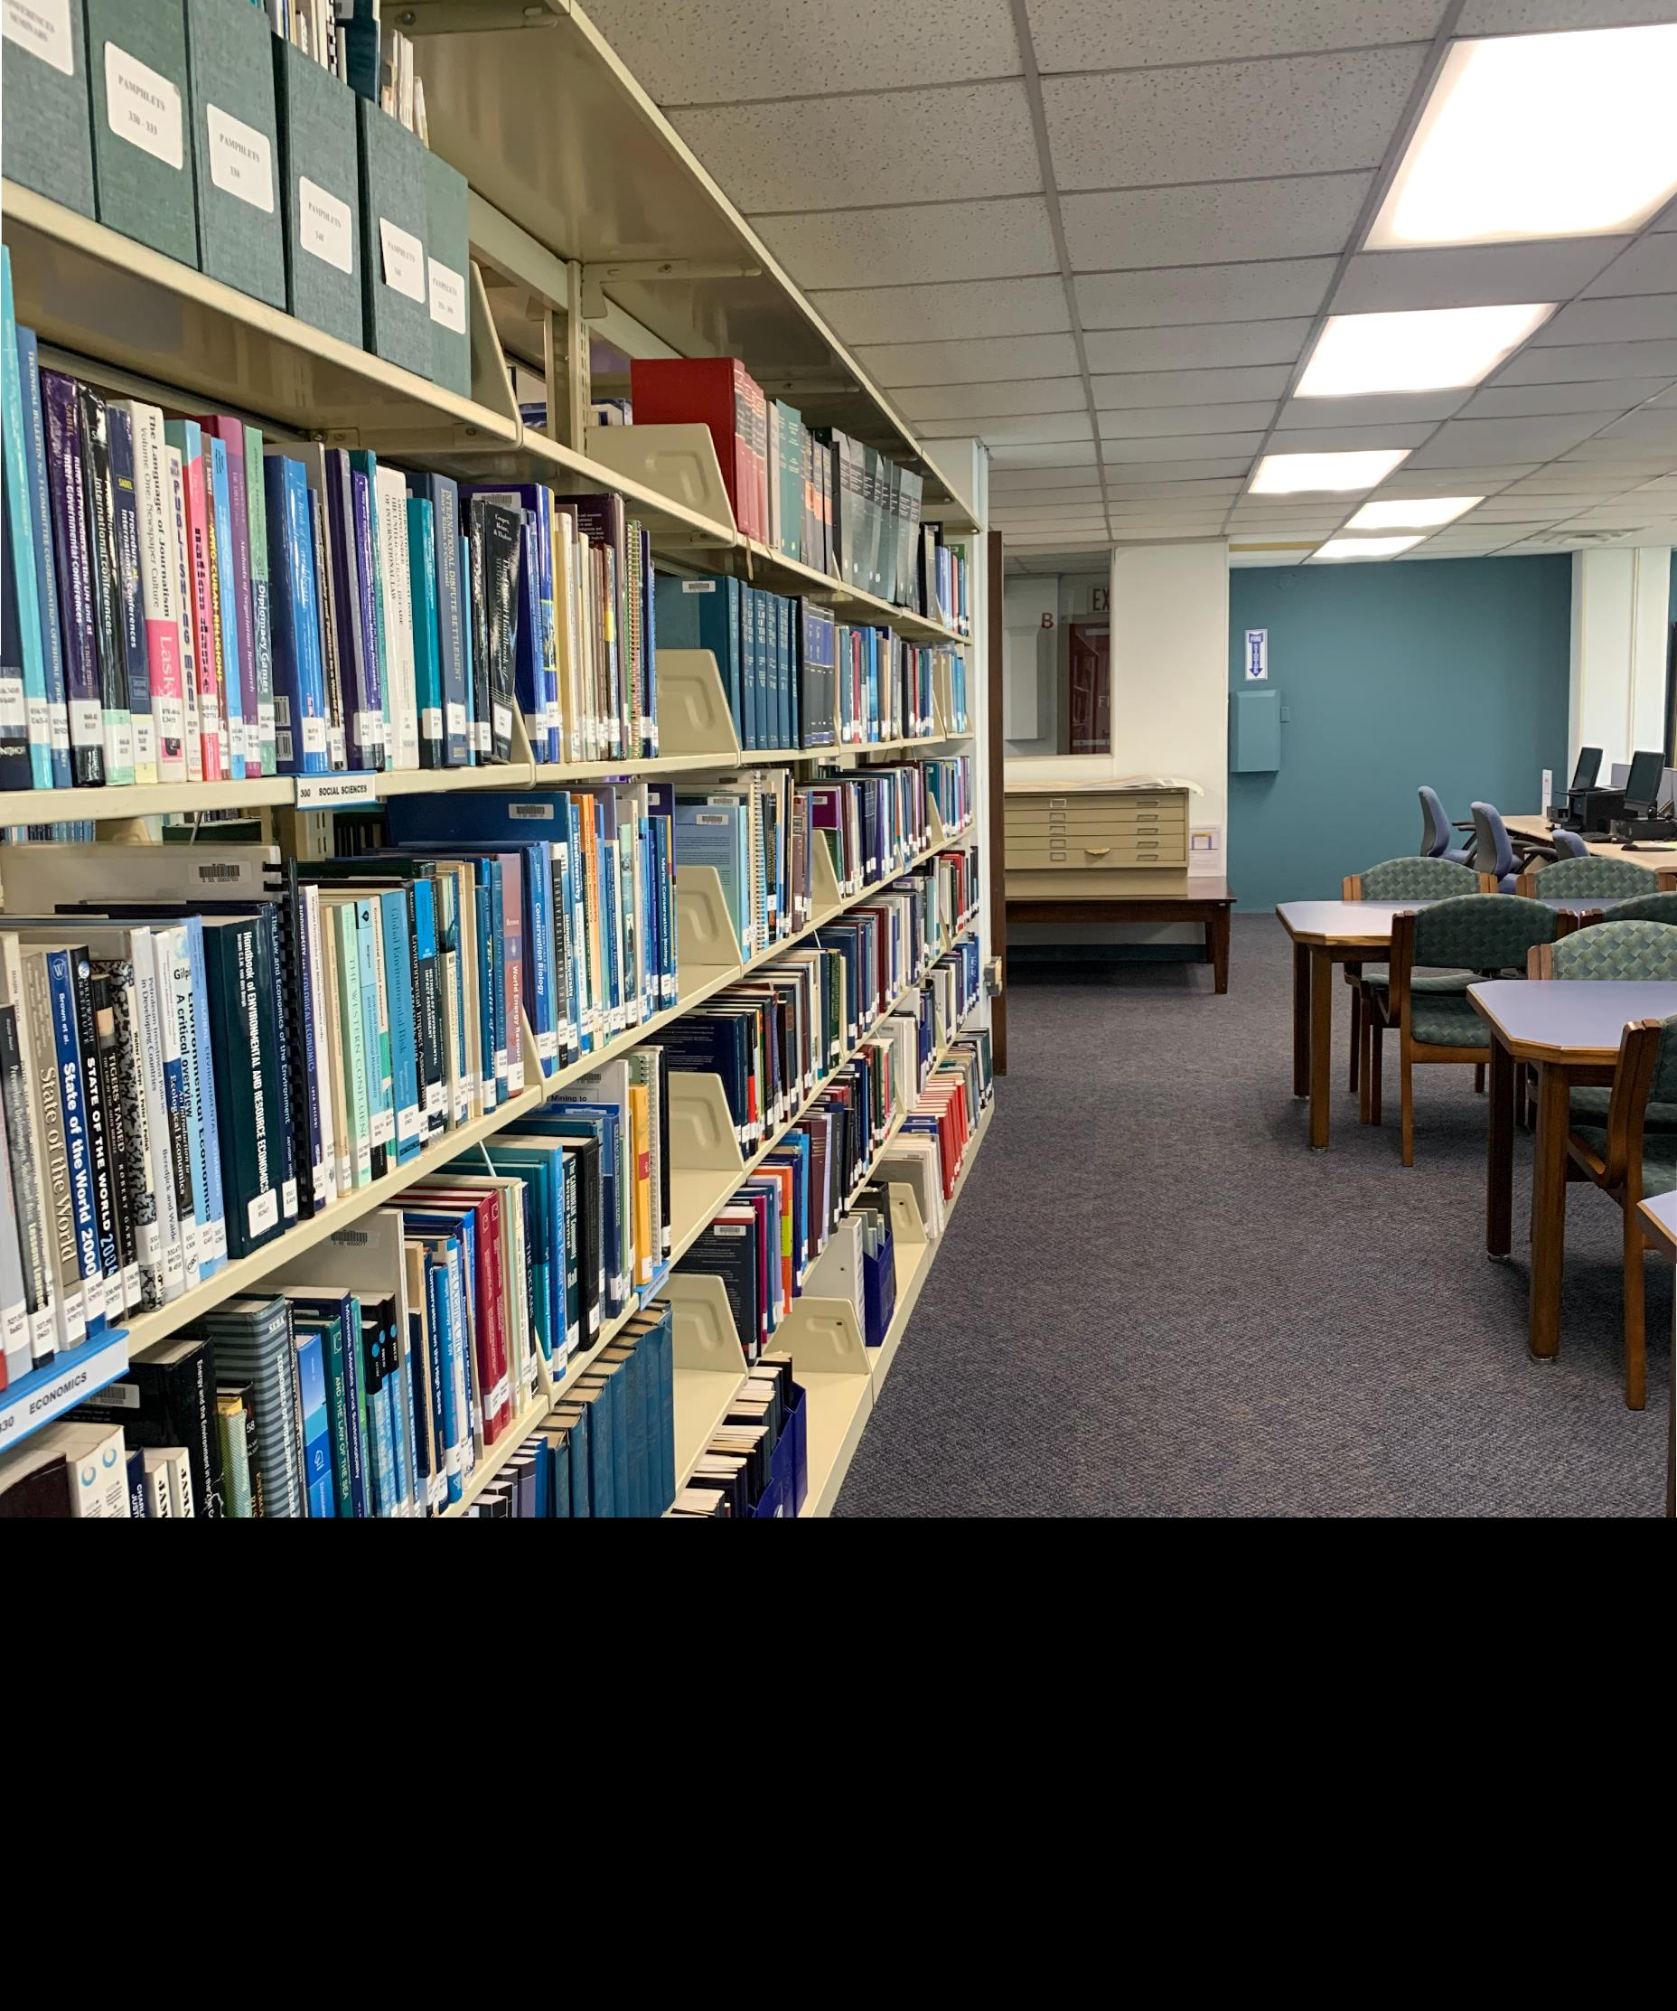
Overview
The Satya N. Nandan Library
  Library management. Information Resources & Services
  ISA Official documents, Storage and Archiving
  Online Public Access Catalogue OPAC Search

Slide 3
Overview
One of the main research centres for the United Nations Convention on the Law of the Sea, in the areas of Law of the Sea, Ocean Affairs, Deep-Seabed Mining and Oceanography
Named for the first Secretary-General, Ambassador Satya N. Nandan in 2008
Holds over 4,000 books, journals and other resources, including online resources for research
Services and the facilities geared to provide information and research for the work of the ISA staff and to meet programme deliverables
Online Public Access Catalogue OPAC Searching

Slide 4
EOS.Web Digital Cloud suite
EOS.Web OPAC Search
ISA PRESENTATION TITLE | MEDIA OUTREACH

Slide 5
ACCESS TO THE OPAC
OPAC (Online Public Access Catalogue)
https://i90023.eos-intl.net/I90023/Index.aspx
Access to the Library Portal is available through either the URL above, or
Through the Satya N Nandan website portal
Login information to the OPAC is on the website

Slide 6
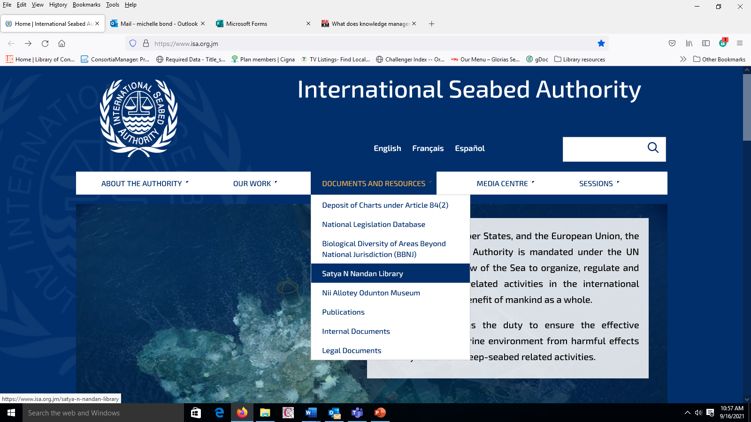

Slide 7
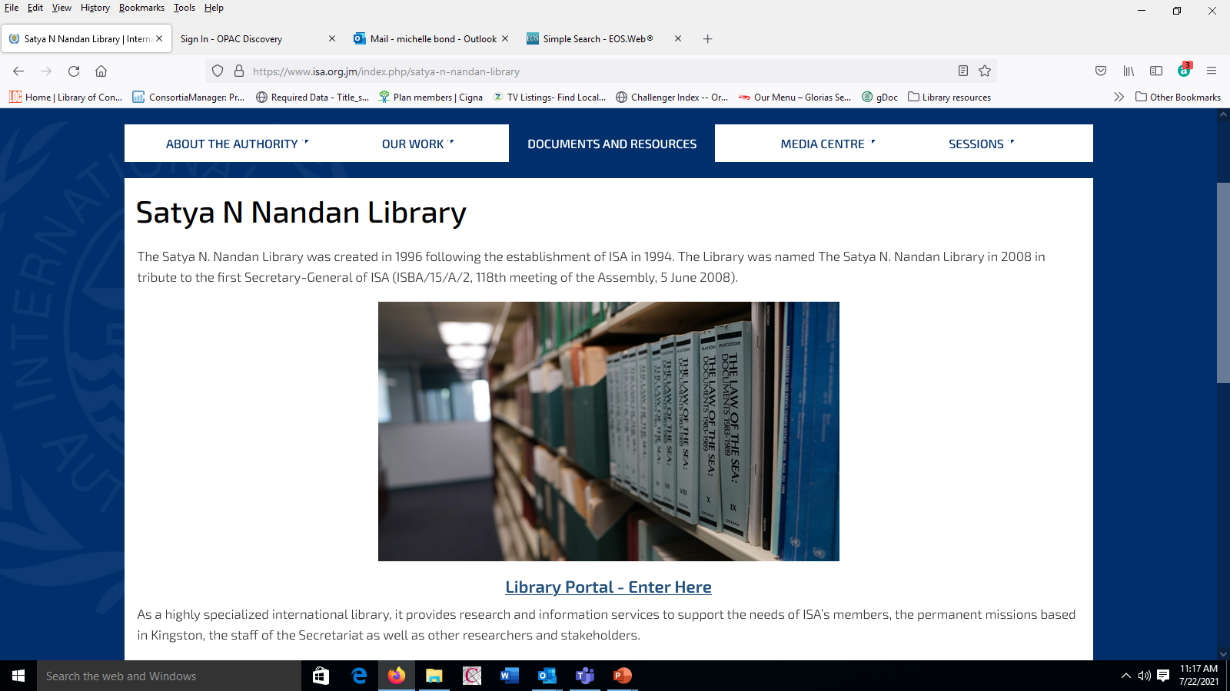

Slide 8
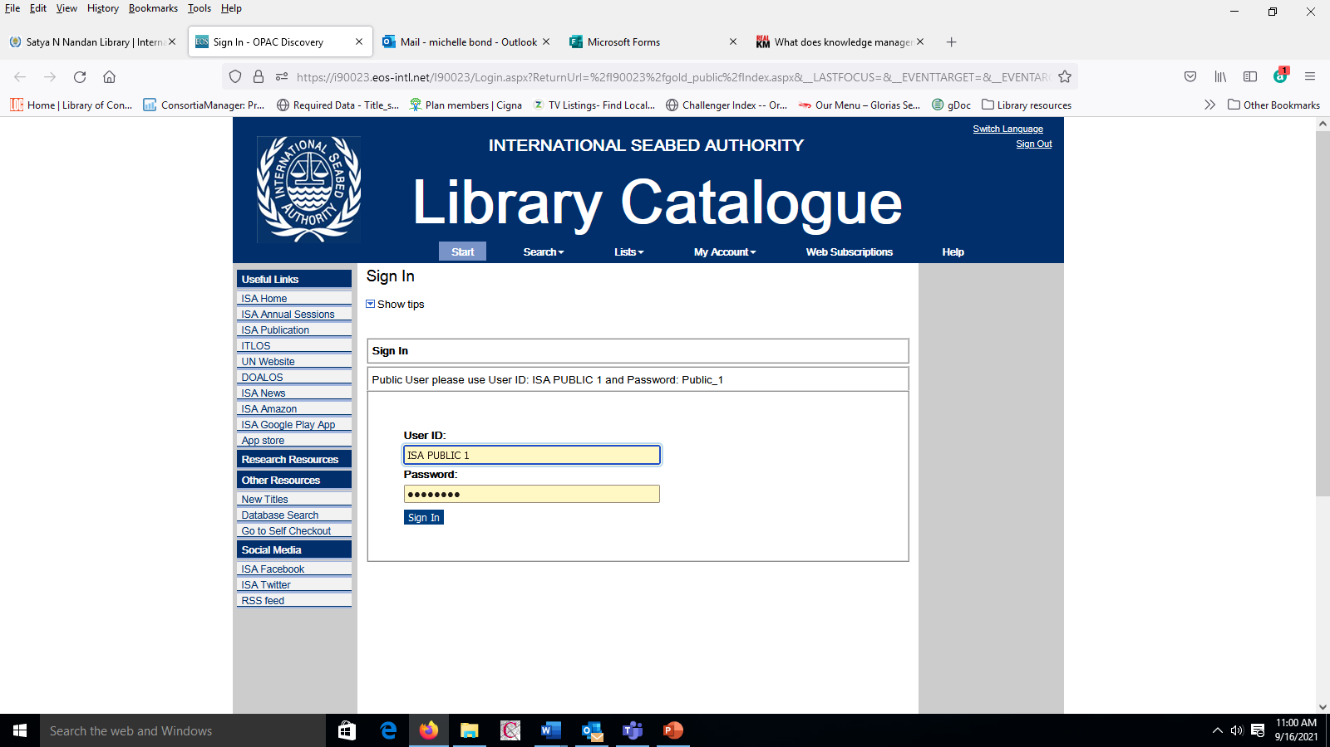

Slide 9
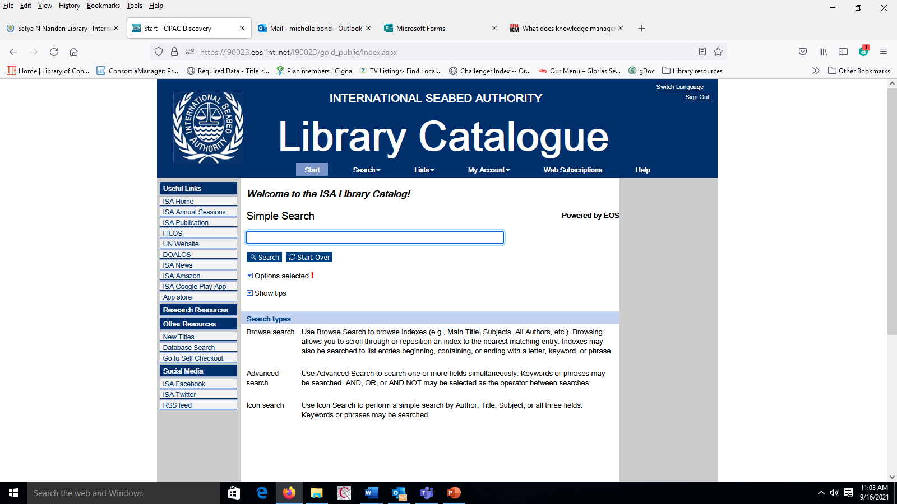

Slide 10
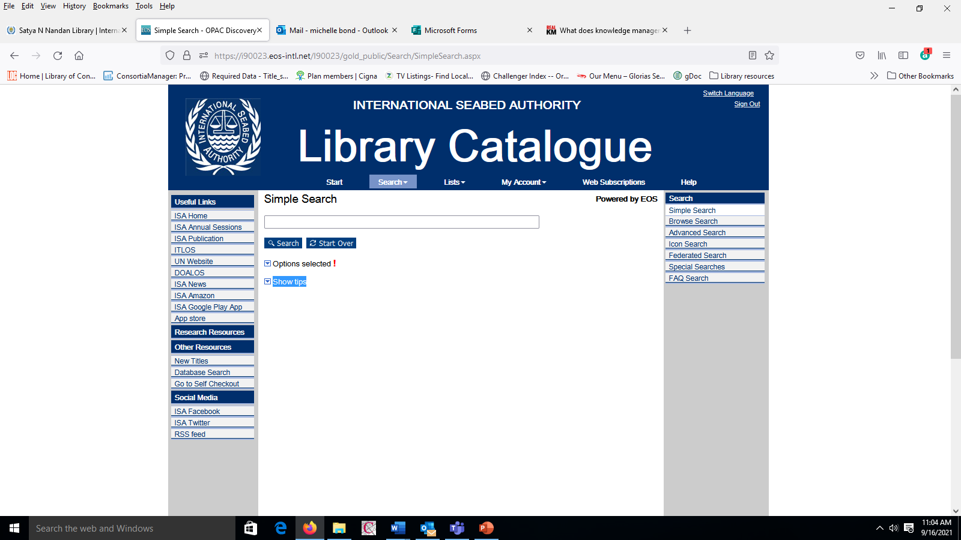

Slide 11
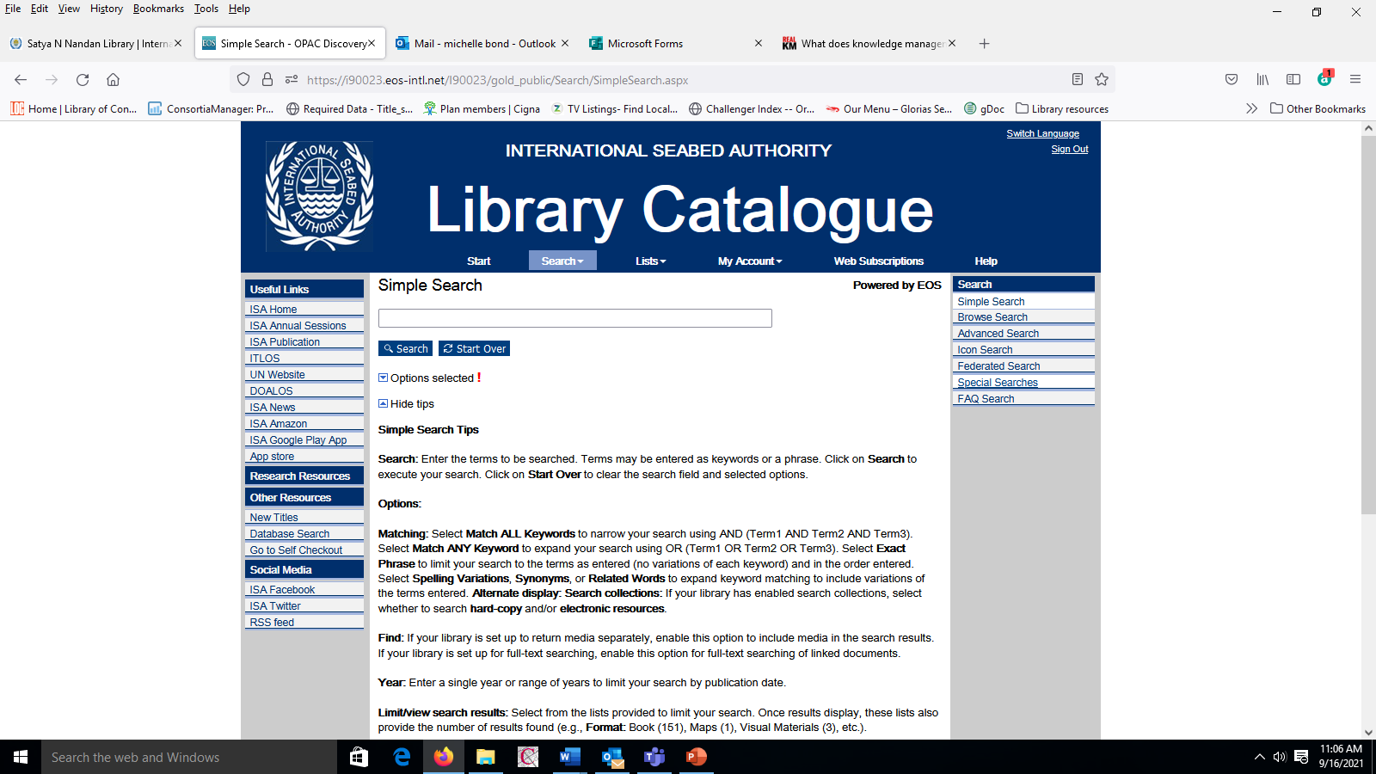

Slide 12
Searching can be done by either
Simple search by:
      Search term or Subject
      Author
      Title
      Browse Search
      Advanced Search
      ICON Search

Slide 13
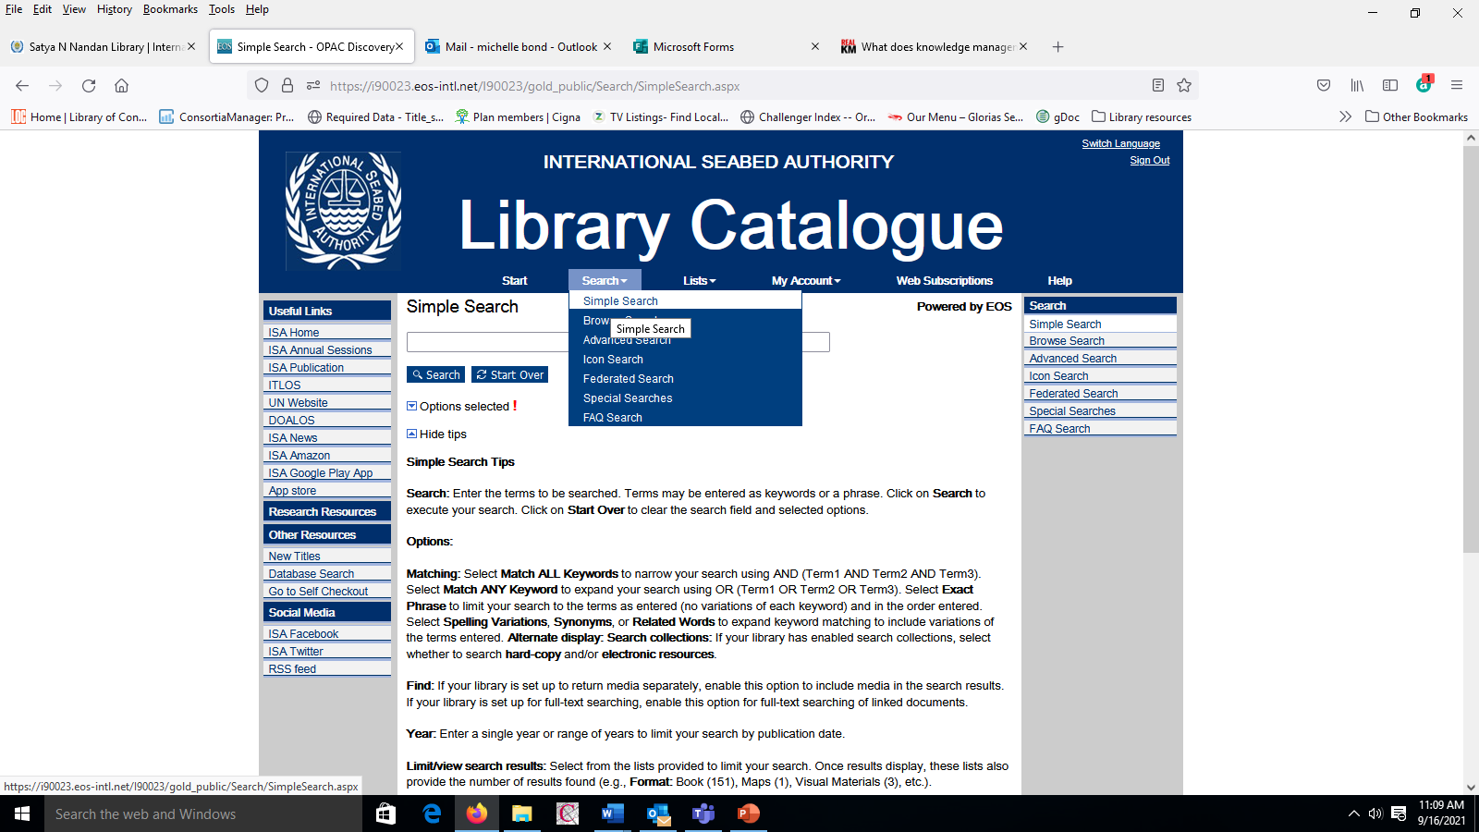

Slide 14
SEARCH BY TERM OR SUBJECT

Slide 15
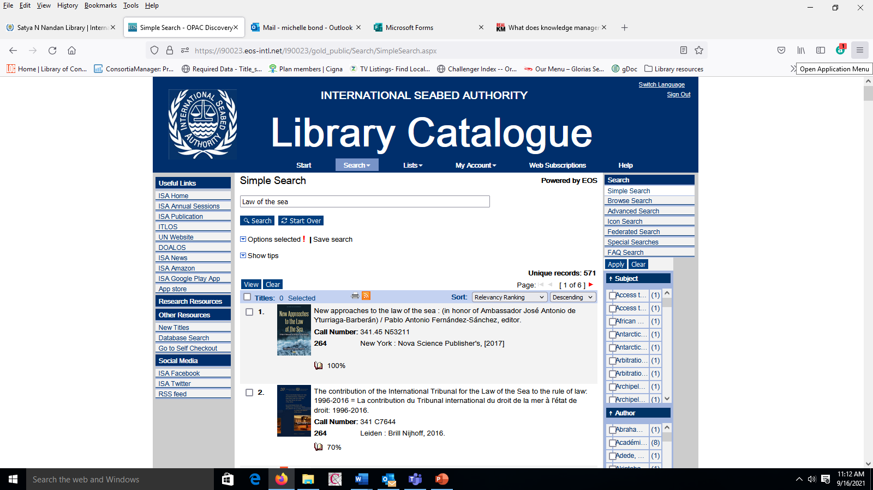

Slide 16
AUTHOR SEARCH

Slide 17
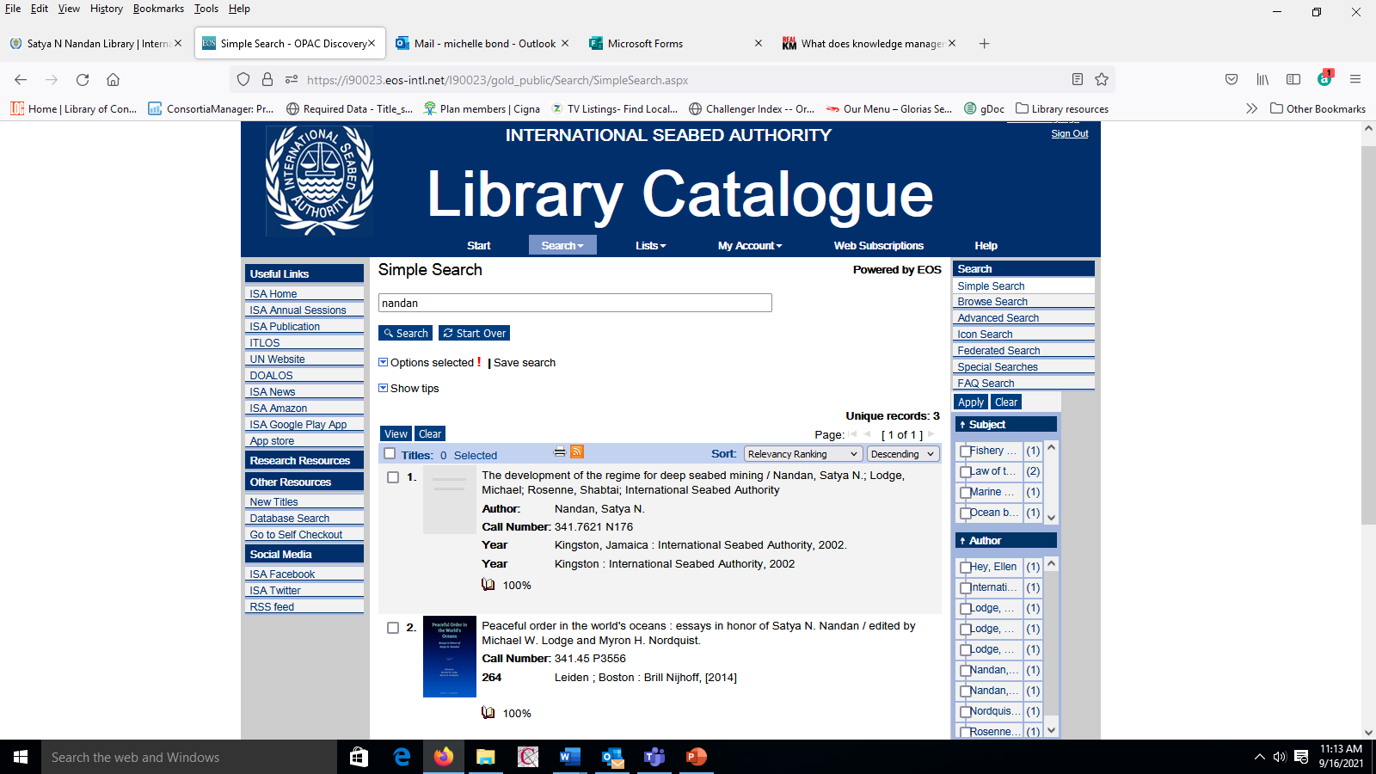

Slide 18
TITLE SEARCH

Slide 19
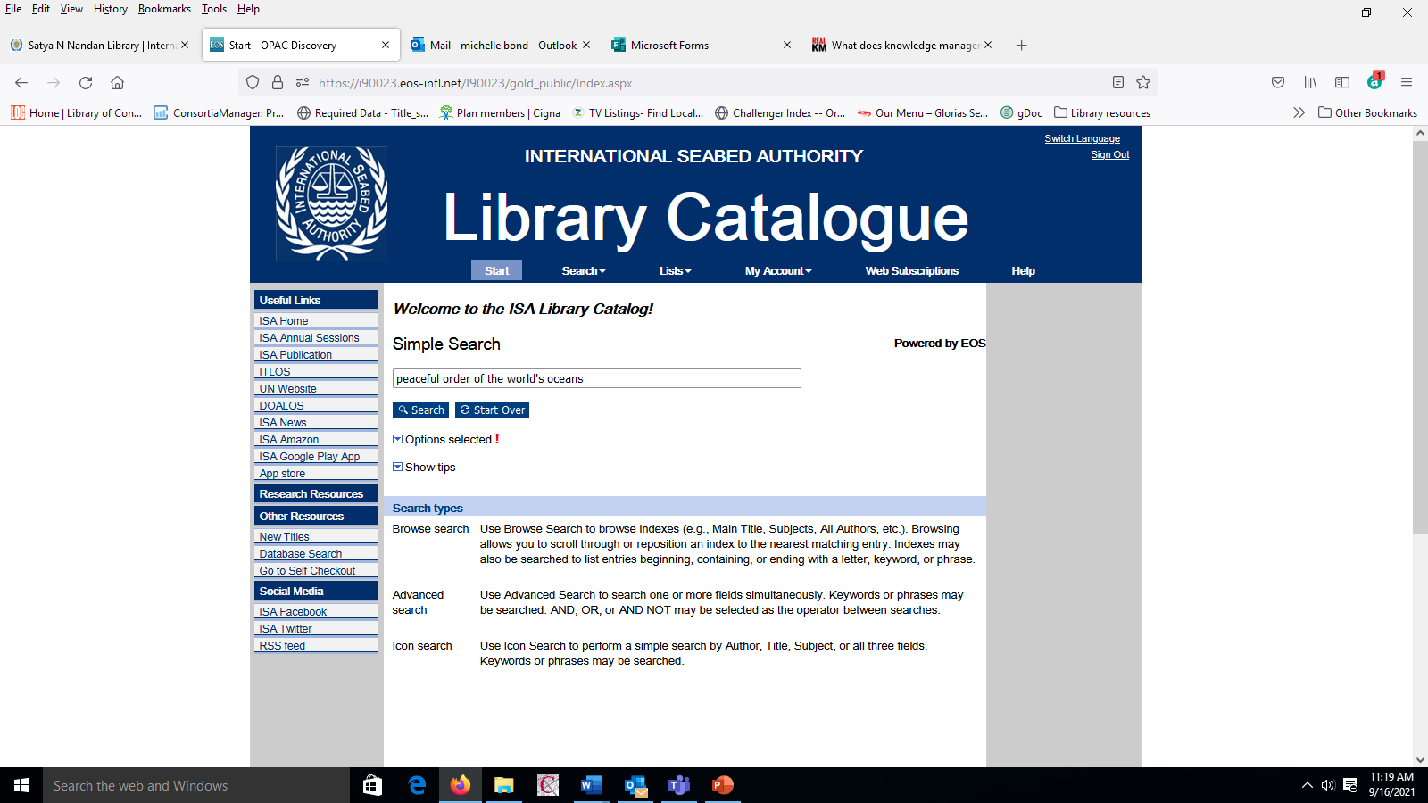

Slide 20
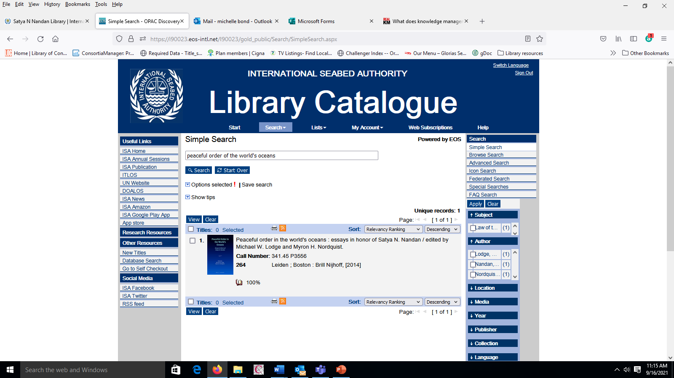

Slide 21
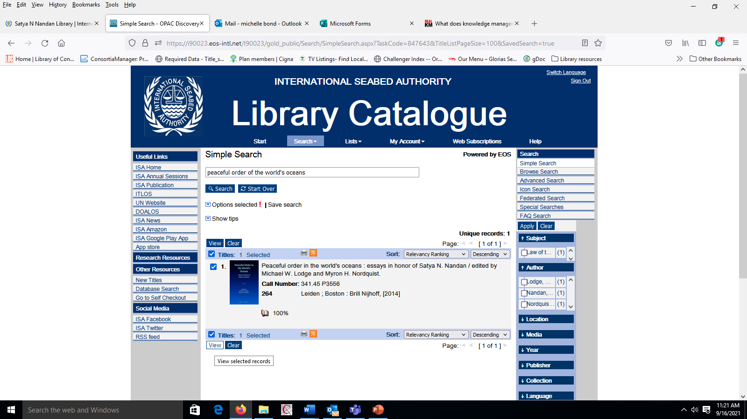

Slide 22
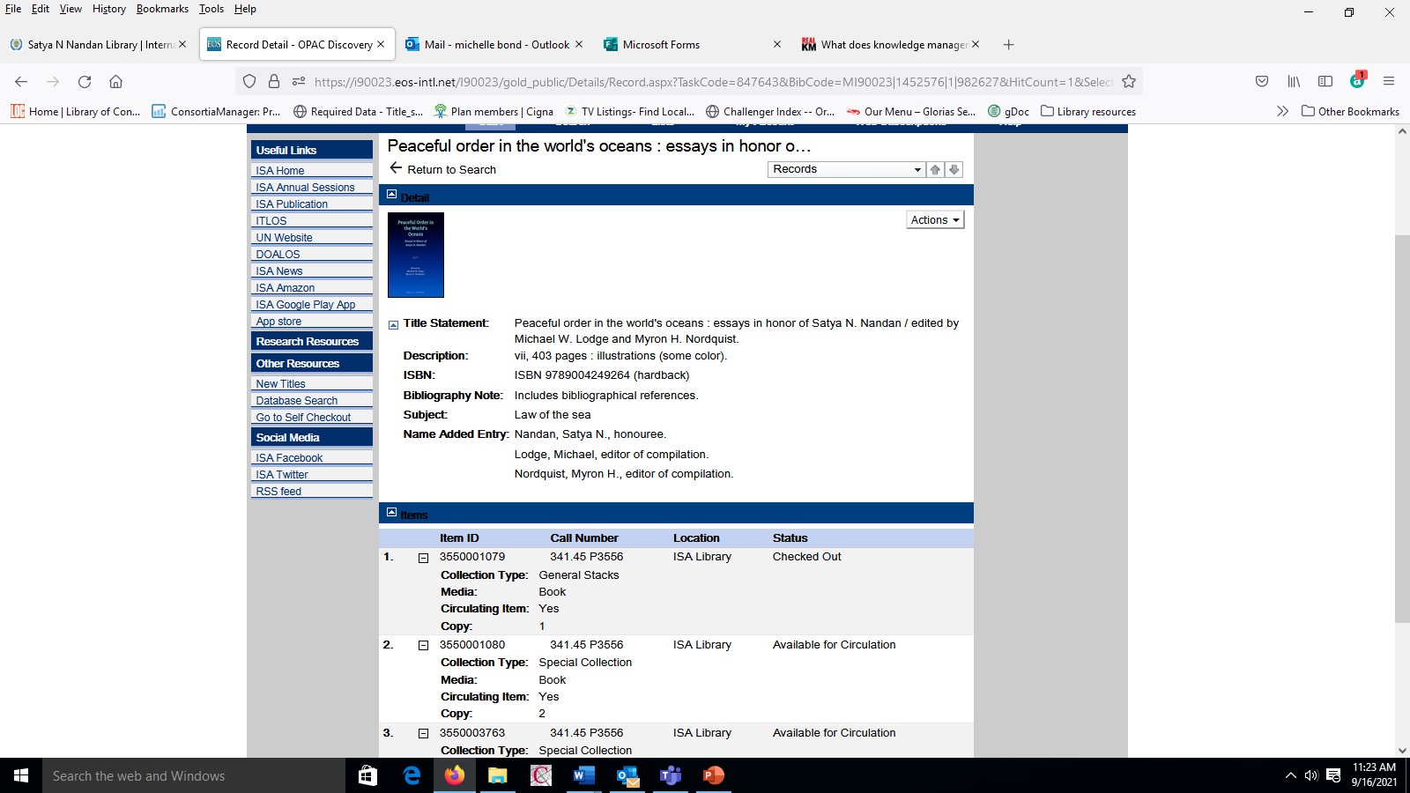

Slide 23
BROWSE SEARCH

Slide 24
Browse Search
There are many different indexes available to you when using the Browse Search option.
These indexes may be defined and customized by your library administrators in order to allow you to limit and better define your search criteria.

Slide 25
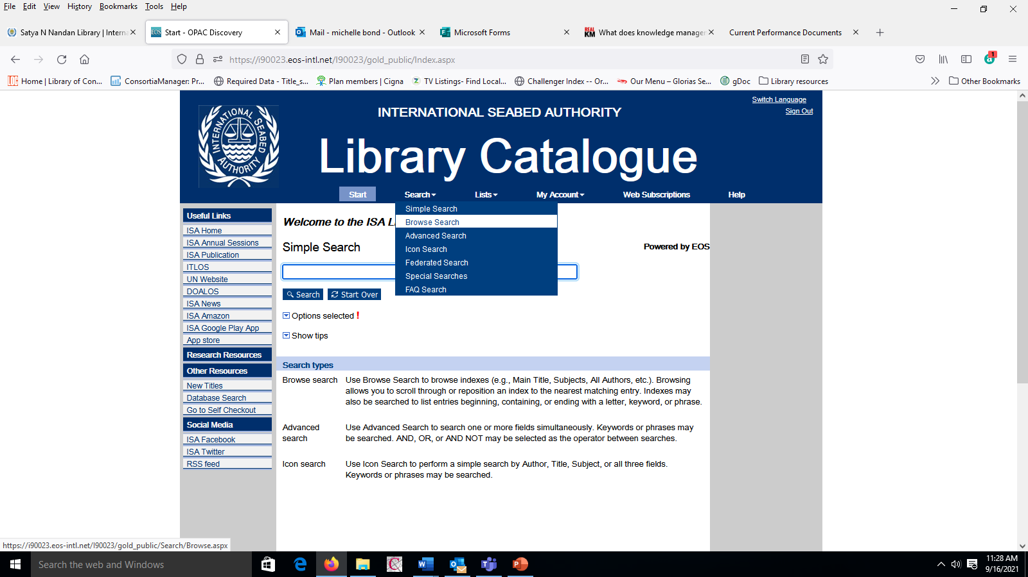

Slide 26
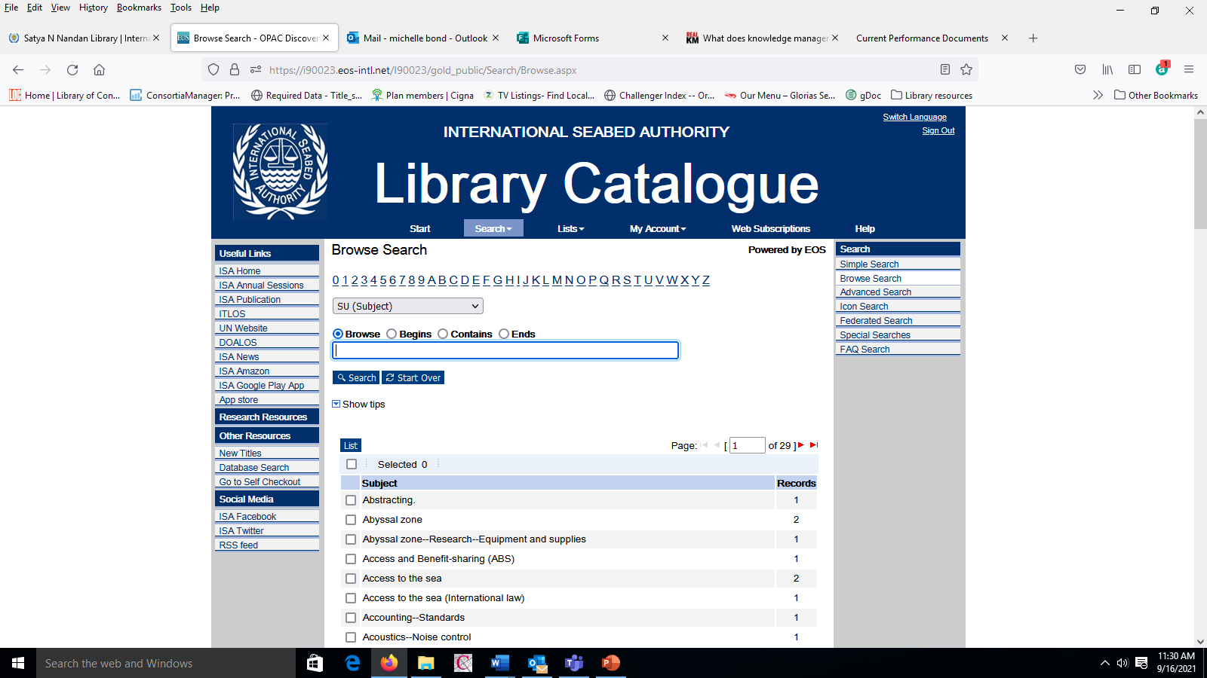

Slide 27


Slide 28


Slide 29


Slide 30


Slide 31
ADVANCED SEARCH

Slide 32
Advanced Search is used when you want to limit your search to specific fields (e.g., limiting a search of the word “Law" in the Title, Author, or Publisher field would yield very different results).
The Advanced Search screen provides fields to easily construct complex field searches.
You may use the AND, OR, and AND NOT operators between the field indicators to narrow your search.

Slide 33
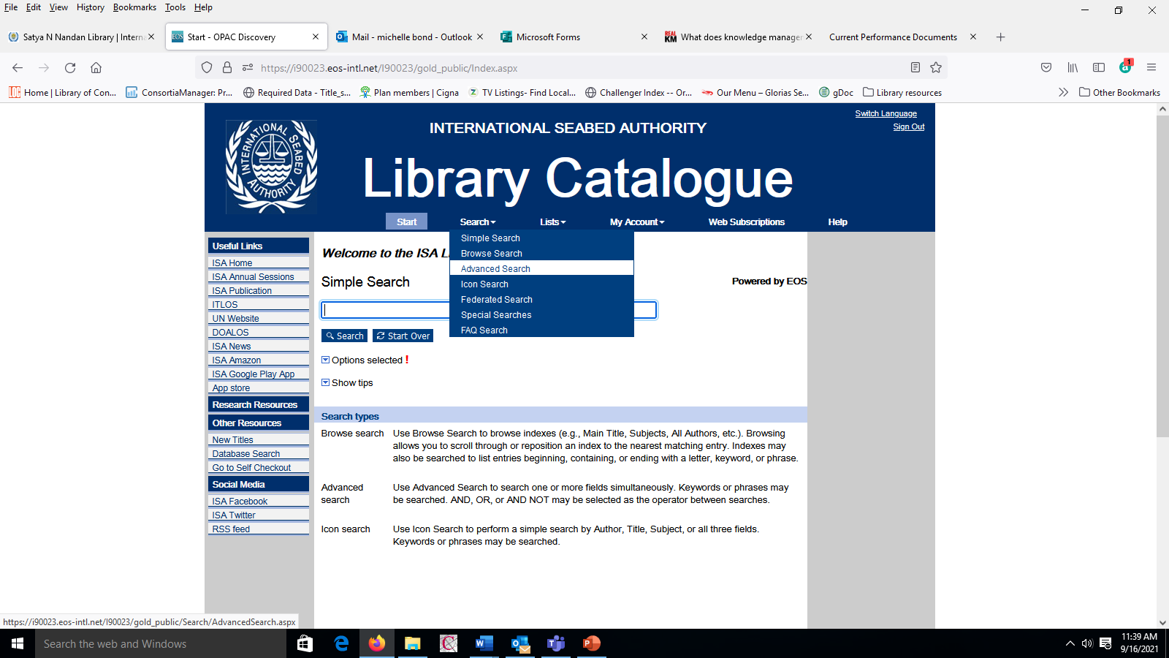

Slide 34
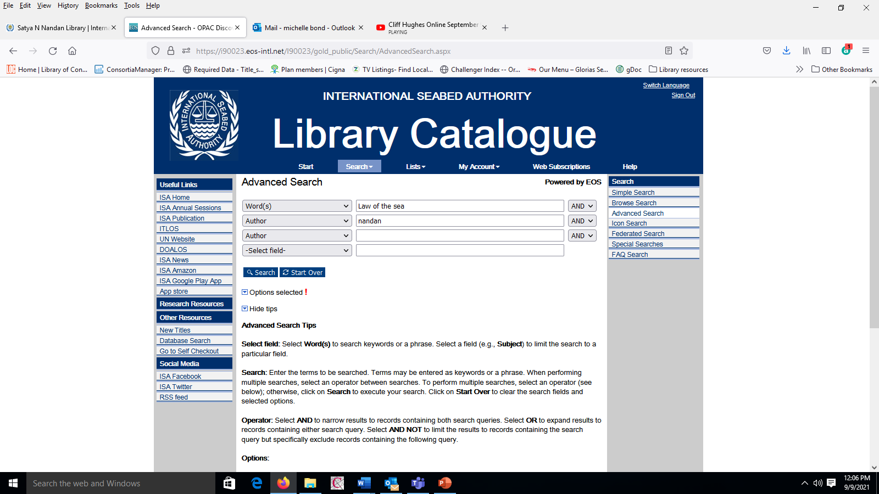

Slide 35
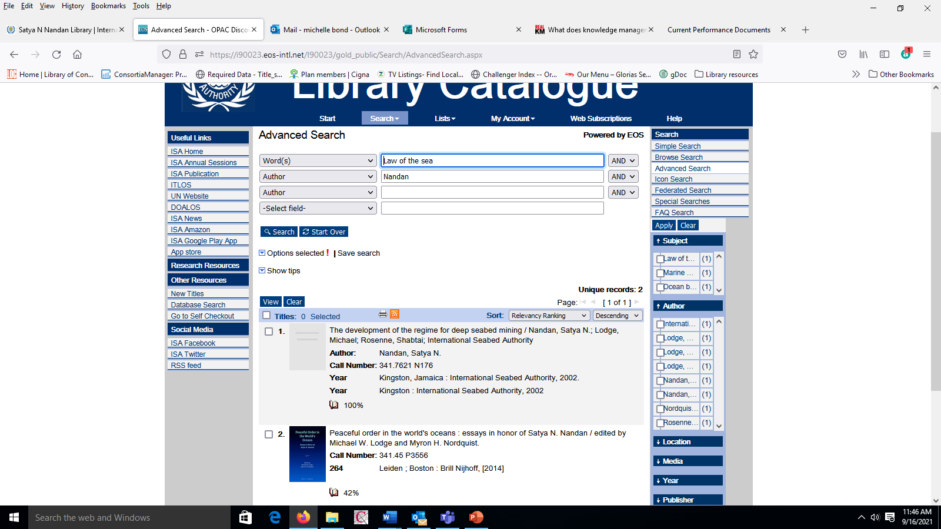

Slide 36
ICON SEARCH

Slide 37
Icon Search is used for searching the most popular fields like Author, Title, Subject, or All of the fields in the record. You also have the option of Matching ALL Keywords, Any Keyword, or an Exact Phrase. Select Linked Media if you’d like to include this field, as well as a date range if applicable. The search may further be limited to Media, Language, Location, Collection or Database specifications. Enter your search criteria and select Search.

Slide 38
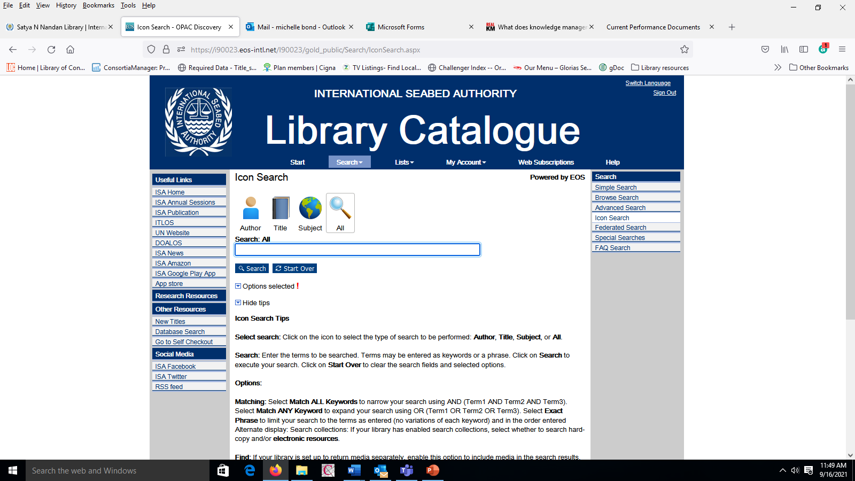

Slide 39
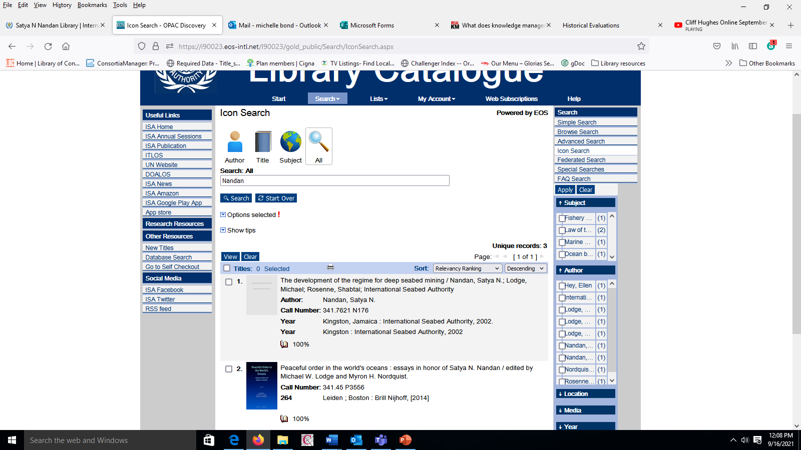

Slide 40
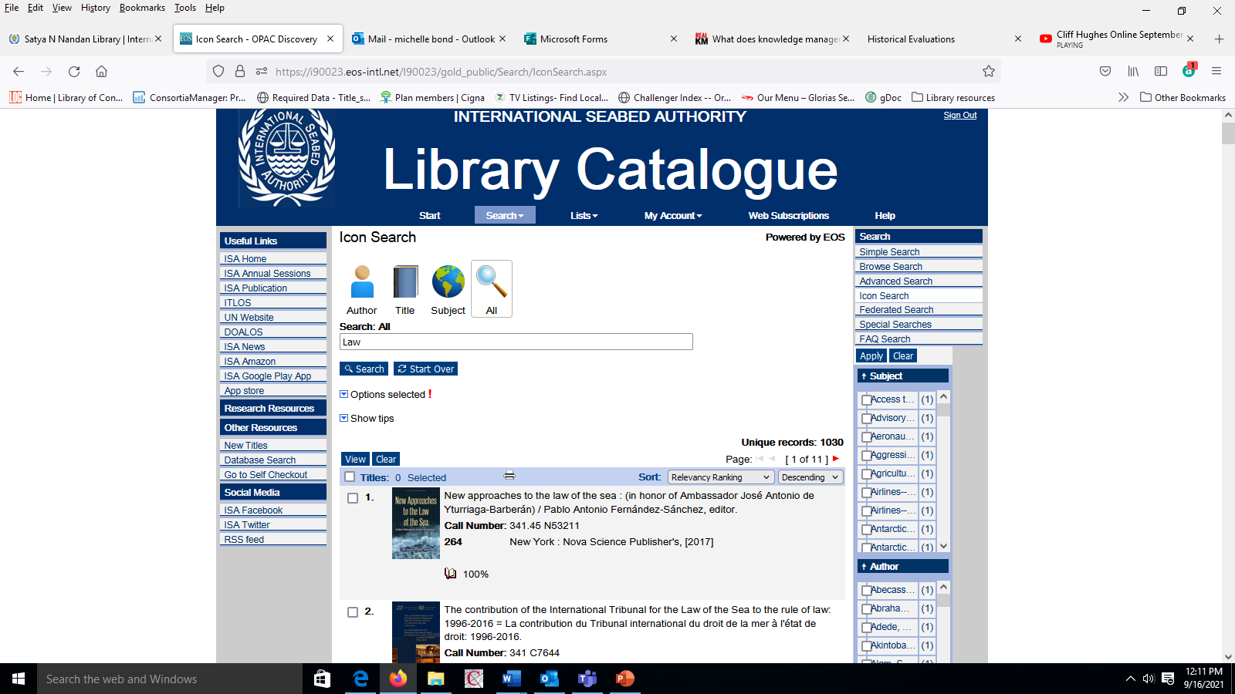

Slide 41
Self checkout
or check out by Library staff

Slide 42
Checking out an item

Slide 43
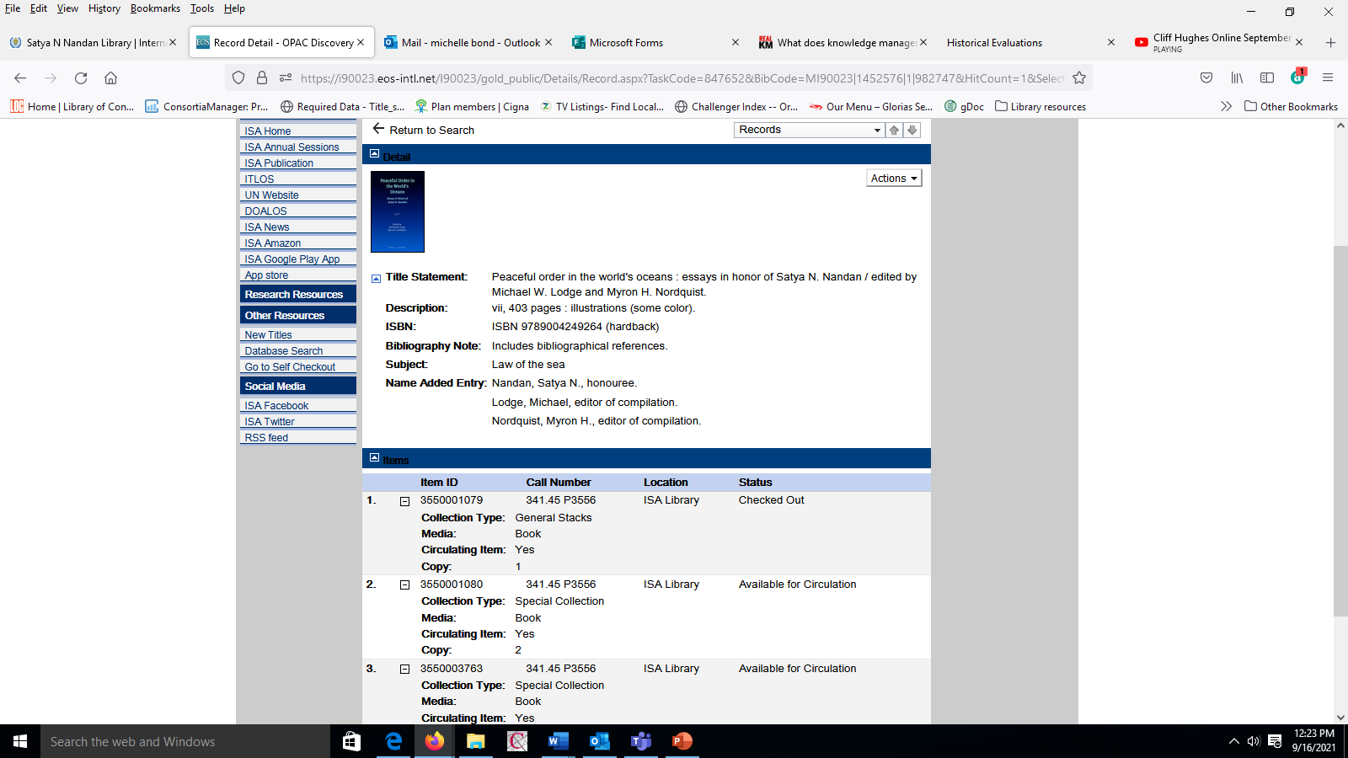

Slide 44


Slide 45
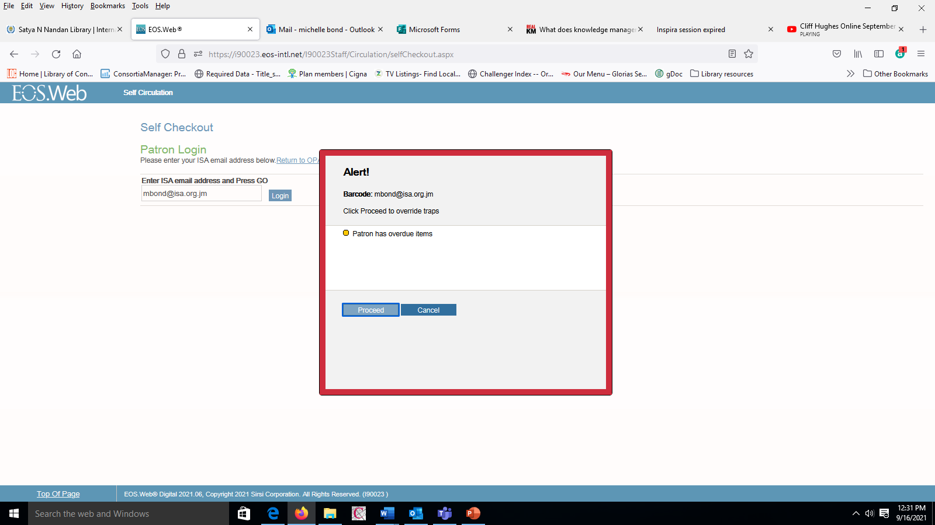

Slide 46
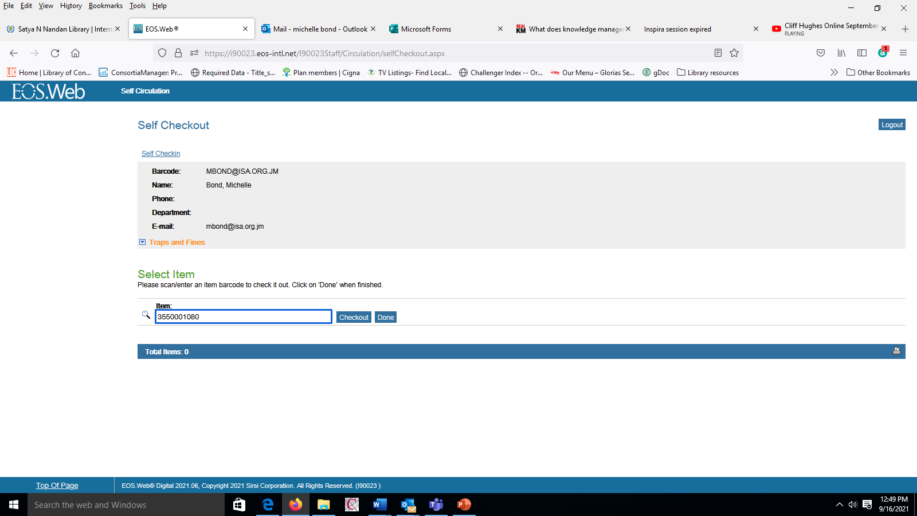

Slide 47
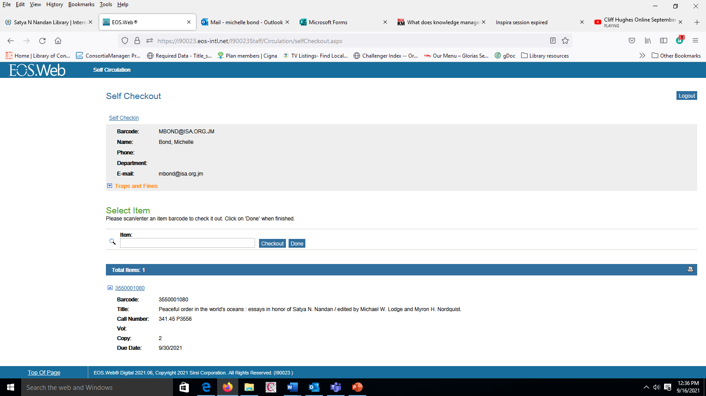

Slide 48
The barcode can be found at the upper right, back corner of the book. The Barcode number is also the Item ID number
To check out a book, enter the item ID or use the barcode to scan, then click checkout.
Scanners are available in the library

Slide 49
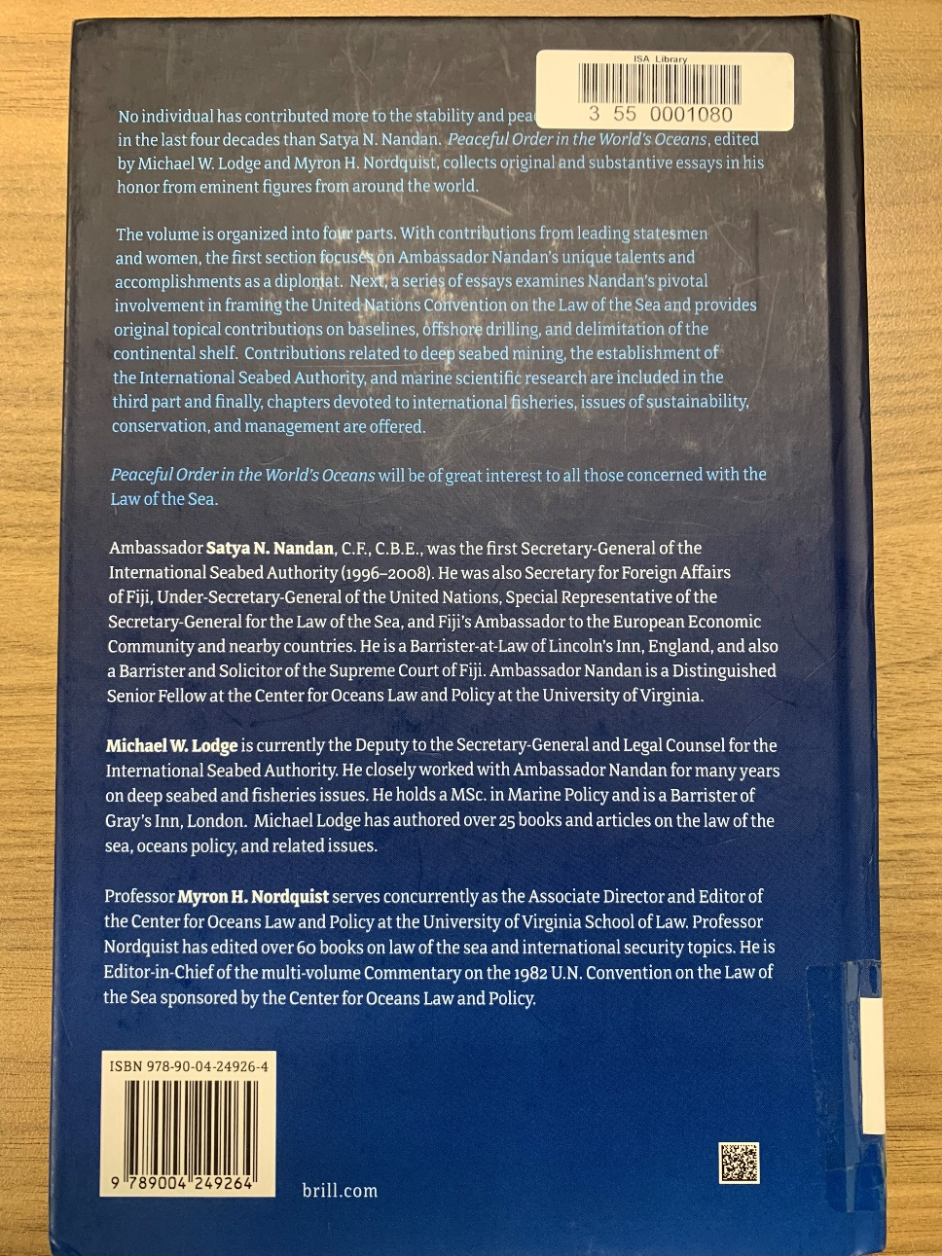
Barcode at upper right back corner of book

Slide 50
Borrowing or removal of publications from Library
Library staff should be informed of any material removed from the Library. This includes the newspapers, journals.
All Publications must be checked out. This can be done by either library staff or using the self-check out option or informing staff of items removed. Library Staff can be informed in person or by phone or email and will then check out the item to the staff member.

Slide 51
Thank you
Michelle Bond
Librarian
2021

Slide 52
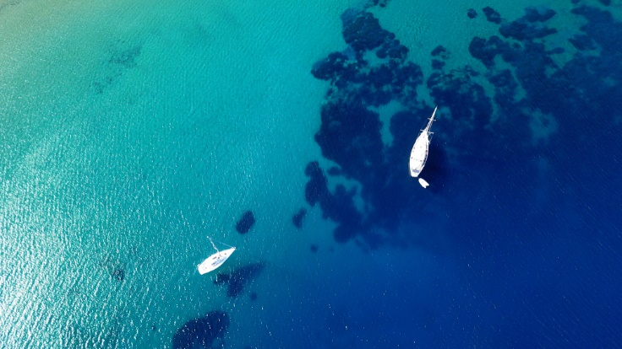

THANK YOU!

