Slide 1
Analysis of Additional Royalty Payments with Reduced Sponsor State CIT
Richard Roth, Randolph Kirchain, Elizabeth Moore
Materials System Laboratory
Massachusetts Institute of Technology
Presentation to International Seabed Authority
Open Ended Working Group on Financial Modeling
Kingston, Jamaica
March 16-17,2023

Slide 2
Agenda
Review of Sponsor State CIT concerns
African Group Proposal for Additional Royalty Payment
Challenges with Choosing a Single Rate
Approaches for Choosing a Rate
Sensitivity Analysis to Additional Rate
Alternative Approaches to Additional Payment Mechanism

Slide 3
Concern that Not All Collectors Will Pay Sponsor State CIT
Without consideration of an additional royalty, the Option #4 suggestion was a 3→7.5/12.5%
  This led to a 45.4% ETR (25% CIT to Sponsor State)
If zero CIT is paid in this same system, the ETR is 29.0%
Concerns that some contractors may not pay any or all of this tax.
  Effective Tax Rate would be much lower than industry standards (40%-50%)
    Is this system still FAIR?
  Contractors have more net revenue that could be shared with ISA
    Are we Maximizing ISA Revenue while allowing contractors to be economically viable?
 | 25% SS Tax | 0% SS Tax
ETR | 45.4% | 29.0%
Lifetime royalty revenue | $5.215B | $5.215B
Lifetime SS CIT tax | $3.988B | $0
TOTAL | $9.203B | $5.215B
Collector IRR | 17.65% | 19.39%

Slide 4
In general, there are two approaches to address this concern
Additional royalty rate from which you can deduct your SS tax payment
Calculate how short (if at all) you are of the ETR and you have to make up the difference through a payment to the ISA

Slide 5
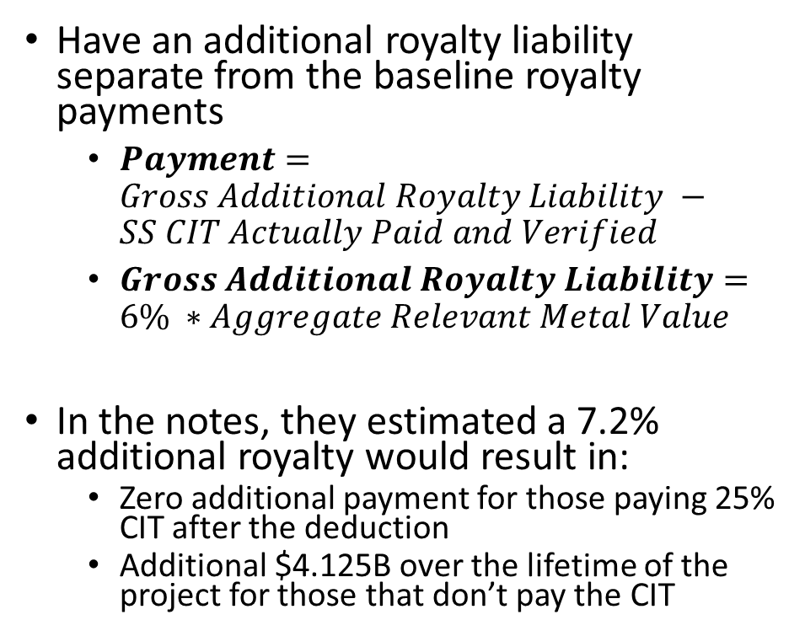
African Group Proposal for Additional Royalty Payment
Goals of this proposal:
  Those contractors paying less (or no) Sponsor State CIT, will be liable for this additional payment and keep them at threshold Effective Tax Rate
  Those contractors paying full 25% Sponsor State CIT, will not have any additional liability
Have an additional royalty liability separate from the baseline royalty payments
  $Payment=Gross Additional Royalty Liability −SS CIT Actually Paid and Verified$
  $Gross Additional Royalty Liability=6\% ∗Aggregate Relevant Metal Value$
In the notes, they estimated a 7.2% additional royalty would result in:
  Zero additional payment for those paying 25% CIT after the deduction
  Additional $4.125B over the lifetime of the project for those that don’t pay the CIT

Slide 6
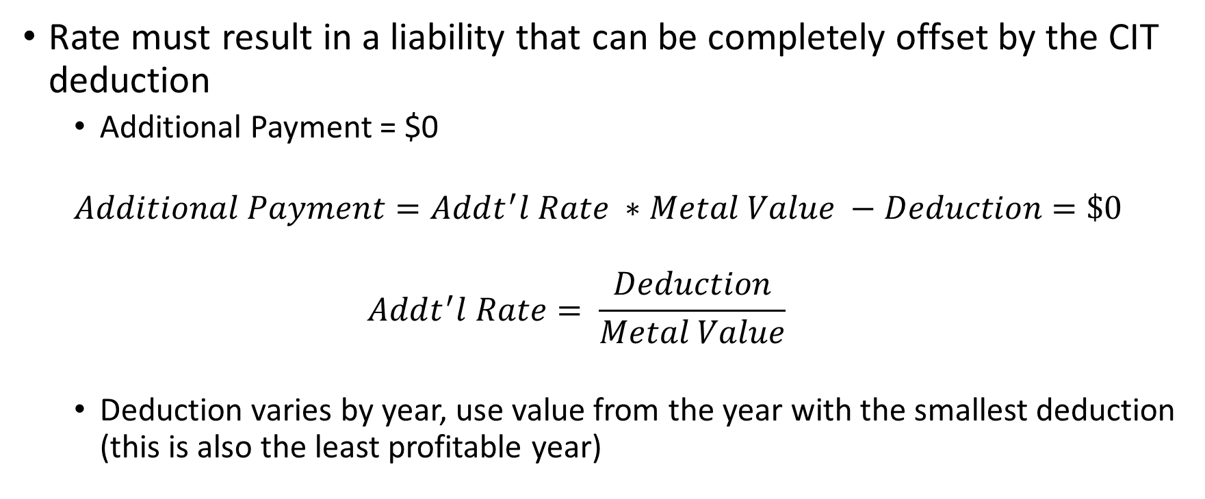
Choosing a rate that requires no additional payment from contractor already paying 25% CIT
Rate must result in a liability that can be completely offset by the CIT deduction
  Additional Payment = $0
  $$Additional Payment=Addt^{′}l Rate ∗Metal Value −Deduction=\$0$$
  $$Addt^{′}l Rate= \frac{Deduction}{Metal Value}$$
  Deduction varies by year, use value from the year with the smallest deduction (this is also the least profitable year)

Slide 7
Implementing Additional Royalty Rate that is Fully Offset by Sponsor State CIT into the Financial Model
Should be straightforward
  Determine amount to be paid in CIT if contractor is paying 25% of profits
  Choose rate which when applied to metal value, gives equal amount
EXCEPT, contractor profit varies with time (even if metals prices and cost are assumed to be constant) → 25% tax on profits also varies with time
  Accounting rules allow for different depreciation over time
  Maintenance CAPEX and other occasional costs don’t occur every year
The rate that would fully be offset by the Sponsor State CIT is different in different years

Slide 8
Challenges with Choosing a Single Rate
CIT payment (deduction) is dependent on profit, which is dependent on the baseline royalty rates (among other things)
→ Cannot set rate independently of setting the baseline rates
System that uses the “least profitable” year as the basis for calculation, is losing out on some revenue
Any system that does not use “least profitable” year as the basis, will require additional payment from contractors that are already meeting their tax obligations
Years 1-4 | Year 5 | Years 6-11 | Years 12-25
No Additional Royalty | High Profits due to: Low Base Royalty in Peirod 1 Profits High → High CIT Payment High CIT Payment → Large Deduction from Additional Royalty | Profits Lower due to: Higher Base Royalty in Period 2 Capital Depreciation Still Occurring Low Profits → Low CIT Payment Low CIT Payment → Limited Deduction from Additional Royalty | Profits Rise due to: Fully Depreciated Capital High Profits → High CIT High CIT Payment → Large Deduction from Additional Royalty
Should we choose a rate that offsets during years 6 to 11 or the latter years?
Notes:
Line with segments in it years 1-4 no addtl royalty
Year 5 profit high, royalty low

Slide 9
Approach #1: Maximum rate that requires no additional payment if CIT = 25%
 | CIT = 25% | CIT = 0%
Year with Lowest Deduction | Year 11 (last year still depreciating)
CIT Payment in that year | $107.4 million
Maximum Add’l Rate that can be fully offset | 4.5%
Effective Tax Rate (no add’l royalty) | 45.4% | 29.0%
Effective Tax Rate (with add’l royalty) | 45.4% (unchanged) | 37.2%
Base Royalty Payment (lifetime) | $5,215 million | $5,215 million
Additional Royalty Payment (lifetime) | $0 million | $2,227 million
Sponsor State CIT Payment (lifetime) | $3,988 million | $0
Total Royalty + CIT Payments (lifetime) | $9,203 million | $7,452 million
Shortfall in Payment for those paying no CIT = $1,751 million
* Based on Option 4: 3% → 7.5%/12.5%, with Threshold ETR = 45%

Slide 10
Approach #2: Additional royalty rate that results in threshold ETR for contractors paying 0% CIT
Additional royalty rate = 7.3% would result in ETR = 45% for contractors paying 0% CIT to sponsor state
 | CIT = 25% | CIT = 0%
Additional Royalty Rate | 7.3% | 7.3%
Base Royalty (lifetime) | $5,215 million | $5,215 million
Additional Royalty before Deduction (lifetime) | $3,629 million | $3,629 million
Additional Royalty (lifetime) | $412 million | $3,629 million
CIT Payment (lifetime) | $3,924 million | 0
TOTAL Royalty + CIT (lifetime) | $9,551 million | $8,844 million
Effective Tax Rate | 46.7% | 45.0%
Contractors paying no CIT, will still pay $707 million less over project lifetime
Contractors paying 25% CIT, will see payments increase by $348 million over project lifetime

Slide 11
Approach #3: Compromise Rate Would Reduce Penalty on those Paying 25% CIT, but others will fall slightly short of threshold ETR
 | CIT = 25% | CIT = 0%
Additional Royalty Rate | 6.0% | 6.0%
Base Royalty | $5,215 million | $5,215 million
Additional Royalty before Deduction | $2,983 million | $2,983 million
Additional Royalty | $139 million | $2,983 million
CIT Payment | $3,966 million | 0
TOTAL Royalty + CIT | $9,320 million | $8,198 million
Effective Tax Rate | 45.8% | 42.3%
Contractors paying no CIT, will still pay $1,122 million less over project lifetime
Contractors paying 25% CIT, will see payments increase by $139 million over project lifetime

Slide 12
Sensitivity to Additional Rate

Slide 13
As the additional rate rises, the ETR gap shrinks. Yet, the additional payment also increases for those paying the 25% CIT
Effective Tax Rate vs Additional Royalty Rate
Additional Payment vs Additional Royalty Rate

Slide 14
As the additional royalty rate rises, there is less incentive to pay 0% CIT
Payment to ISA vs Additional Royalty Rate
Total Tax vs Additional Royalty Rate

Slide 15
Summary of the Challenges of an Additional Royalty with the CIT Deduction Mechanism
Impossible to simultaneously fully meet both goals
  ETR thresholds for contractors paying 0% CIT
  No additional payment for those paying full 25% CIT
    Therefore their ETR remains at threshold value
Dependence on prior knowledge of contractors costs
  Highly uncertain at this point
  More will be known as we approach beginning of production

Slide 16
Could the Other Approach to the Additional Payment Mechanism Solve Challenges?
Other approach: Calculate how short (if at all) you are of the ETR and you have to make up the difference through a payment to the ISA
Potentially, but system would be complex:
  Calculate ETR
    If ETR is the total payments divided by before tax profit, calculating the total payments is straightforward. Calculating profit means I need an accounting system
      Cost, revenues, and tax deductions
Notes:
Could the second approach, where each contractor calculates their ETR and in a shortfall makes an additional payment, solve this problem?
Compelx
Set up rule to calculate ETR, which varies by year
Set up a mechanism for calculating the additional payment to bring them up to the ETR threshold

Slide 17
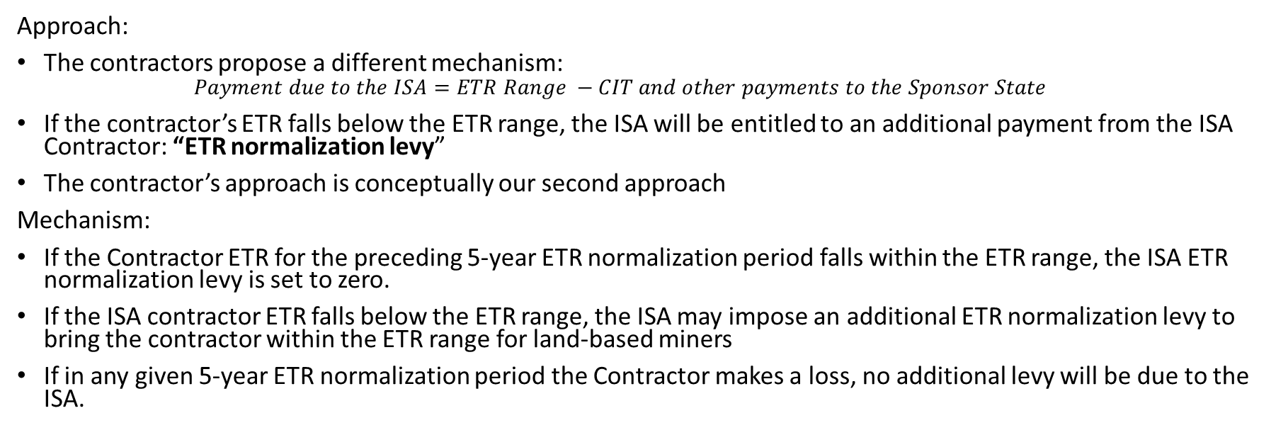
Contractor Submission Offers Another Mechanism
Approach:
The contractors propose a different mechanism:
  $$Payment due to the ISA=ETR Range −CIT and other payments to the Sponsor State$$
If the contractor’s ETR falls below the ETR range, the ISA will be entitled to an additional payment from the ISA Contractor: “ETR normalization levy”
The contractor’s approach is conceptually our second approach
Mechanism:
If the Contractor ETR for the preceding 5-year ETR normalization period falls within the ETR range, the ISA ETR normalization levy is set to zero.
If the ISA contractor ETR falls below the ETR range, the ISA may impose an additional ETR normalization levy to bring the contractor within the ETR range for land-based miners
If in any given 5-year ETR normalization period the Contractor makes a loss, no additional levy will be due to the ISA.
How will ISA verify calculation of ETR?
5-year Normalization Period eliminates some of the issues surrounding year-on-year variability
Notes:
How do they calculate this each year?

Slide 18
Additional Issue: Switching to Nodule Transfer Price as Royalty Basis
Challenge: No arms length price currently exists, but one will likely develop when industry is mature
Royalty rate on Nodule Transfer Price:
  more in line with current land based mining practice
  Simple to administer (if there is a global benchmark price)
  Would automatically address concerns about other value metals extraction from nodule
    The market price for nodules would reflect this value

