Slide 1
The African Group’s Amended Proposal for an Additional Royalty Equalisation Measure
May 2023

Slide 2
The African Group’s nine tests for the payment regime
The African Group’s June 2022 Submission* proposed nine tests for the payment regime:
  Test 1: The Fair Compensation to Mankind Test;
  Test 2: The Whenever Miners make Profits, Mankind must be Compensated Test;
  Test 3: The Economic Efficiency Test;
  Test 4: The Rates of Payment Test;
  Test 5: The Progressivity Test;
  Test 6: The Full Compensation to Land Based Mining Countries Test;
  Test 7: The Simple to Audit and Administer Test;
  Test 8: The Knowledge and Transparency Test; and
  Test 9: The Sensitivity Test.
These tests are drawn from UNCLOS, the 1994 Implementing Agreement and international best practice in extractive industry taxation.

Slide 3
Test 4: The rates of payment test
The most relevant test for today’s discussions is ‘Test 4: The rates of payment test’.
The 1994 Implementing Agreement mandates in Section 8.1.b that:
‘The rates of payments under the system shall be within the range of those prevailing in respect of land-based mining of the same or similar minerals in order to avoid giving deep seabed miners an artificial competitive advantage or imposing on them a competitive disadvantage;’
The 1994 Implementing Agreement does not define ‘the system’. This term could be regarded as referring to the ISA payment regime only. This interpretation would imply that the rates of payment in the payment regime must equal the rates of payment in land-based mining with no account taken of sponsoring state tax.
An alternative interpretation is that ‘the system’ refers to both the ISA payment regime and sponsoring state taxes. This would imply that the rates of payment from sponsoring state taxes and the ISA payment regime combined must be equal to the rates of payment under land-based mining tax regimes.

Slide 4
Land-based miners pay many different taxes
Main Extractive Industry Taxes**
 | Names and Examples
Taxes on the right to exploration or mining. | Annual Fees, Area Fees, Signature Bonuses and Production Bonuses.
Taxes on costs/inputs | Customs Duties, Contractor Withholding Tax and VAT
Taxes on the value of mine output | Ad-valorem Royalties.
Taxes on Profits | Corporate Income Tax, Ringfenced Mining or Petroleum Taxes, Profit Shares
Additional Profit Taxes / Cash Flow Taxes (taxes on profits above a certain level) | Additional Profit Taxes (e.g. a 20% tax on profits when the IRR exceeds 17.5%)
Taxes on remitted profits | Dividend Withholding Tax

Slide 5
What is a reasonable interpretation of ‘rates of payment’?
The effective tax rate is a reasonable interpretation of ‘rates of payment’
Effective Tax Rate = All payments to the Government over the life of the mine ÷ total pre-tax profits over the life of the mine.

Slide 6
What are the effective tax rates for the largest land-based miners of cobalt, copper, manganese and nickel?

Slide 7
What are the effective tax rates for the largest land-based miners of cobalt, copper, manganese and nickel?
The sample average effective tax rate across the 10 jurisdictions modelled in the previous graph is 46%.
This is consistent with academic studies of average effective tax rates for land-based mining.
Specifically:
  Otto et al (2000)**** found an average effective tax rate of 47%;
  the Commonwealth (2009)***** reports an average effective tax rate of 49%;
  IGF (2022)****** provides a range of 40% to 60% for average effective tax rates; and
  Bouterige et al (2020)******* reports an average effective tax rate of 44%

Slide 8
Whether the effective tax rate for deep-seabed mining is approximately the same as, or much lower than, land-based mining depends on assumptions about sponsoring state tax (assuming a base ISA royalty of 3%/7.5%to12.5%)

Slide 9
Sponsoring state tax
The publicly available sponsorship agreements for Tonga Offshore Mining Limited and Nauru Ocean Resources Inc provide complete exemptions from corporate income tax.
Thus, in our view, it is not reasonable to assume that contractors are paying sponsoring state corporate income tax at a rate of 25%
There is a strong rationale for an equalisation measure.
An equalisation measure would work by ensuring that contractors that were paying no or little tax to their sponsoring state paid more to the ISA. However, contractors paying significant tax to their sponsoring state would pay little or nothing additional under the equalisation measure to the ISA.
The idea would be to ensure an effective tax rate of 47% regardless of sponsoring state corporate income tax exemptions.

Slide 10
African Group’s initial proposal for an additional royalty equalisation measure
An additional 6% royalty starting in the 5th year of commercial production against which actually paid and verified sponsoring state corporate income tax is creditable.
We proposed a rate of 6% as at this rate a contractor paying a 25% sponsoring state corporate income tax would not face any additional payments to the ISA.

Slide 11
Criticisms of the African Group’s additional royalty and our response
Criticism 1 | Our response
In some years corporate income tax payments may be higher than the additional royalty; while in other years corporate income tax payments may be lower than the additional royalty. As there is no mechanism for carrying forward uncredited corporate income tax payments, this can lead to a contractor’s overall tax burden increasing even when overall corporate income tax payments equal or exceed the additional royalty. | This is a valid criticism of the additional royalty as originally proposed. We propose that actual cash corporate income tax payments that are not credited against the royalty in the year they are made are carried forward until they have been fully credited.

Slide 12
Criticisms of the African Group’s additional royalty and our response
Criticism 2 | Our response
The additional royalty starts in the 5th year of commercial production. However, there is no guarantee that profits and corporate income tax payments will be made in year five, profits may not be made until later. | This criticism has some/limited merit. While it is true that profits could start later, the economic models we have (e.g. the MIT model) suggest that there will be profits and CIT payments by the 5th year of commercial production. However, to reduce the risk to contractors the additional royalty could be delayed until the 6th year of commercial production.

Slide 13
Criticisms of the African Group’s additional royalty and our response
Criticism 3 | Our response
Contractor corporate income tax payments to the sponsoring state could be lower than forecast due to higher costs and lower profits. | We only concur with this point to a limited extent. While it is true that costs could be higher than expected, the best estimates we have do show that deep-seabed mining is likely to be profitable. In addition, some contractors have corporate structures whereby sister companies provide services to the contractor. In such a situation, higher costs for the contractor are higher revenues and potentially profits for its sister company and do not necessarily imply lower overall profits for the parent company.

Slide 14
Criticisms of the African Group’s proposal and our response
Criticism 4 | Our response
The additional royalty only allows corporate income tax payments in the sponsoring state to be credited against the additional royalty. Contractors paying a royalty to thier sponsoring state shouldn’t be disadvantaged. All payments to sponsoring states should be creditable. | We broadly concur with this point. We agree that all tax/royalty type payments to the sponsoring state should be creditable.

Slide 15
African Group amended proposal
An additional royalty of 8% starting in the 6th year of commercial production against which all tax and royalty payments to the sponsoring state are creditable.
Any tax and royalty payments to the sponsoring state that are not fully credited against the additional royalty in the year that they accrue may be carried forward to future years until they are fully credited against the additional royalty.
The additional royalty has gone up from 6% (original proposal) to 8% (amended proposal) as the way the royalty base is calculated has changed. Specifically the royalty base is now calculated using manganese ore as opposed to the higher priced electrolytic manganese metal.

Slide 16
Results for the African Group’s amended proposal (8% additional royalty and ISA base royalty of 3%/7.5%to12.5%) (a)

Slide 17
Results for the African Group’s amended proposal (8% additional royalty and ISA base royalty of 3%/7.5%to12.5%)

Slide 18
Advantages of the African Group’s amended -proposal
The additional royalty is beneficial to the mankind as it can increase (but not decrease) ISA revenues from commercial mining.
The additional royalty is highly advantageous to sponsoring states, as it:
a.) encourages contractors to pay taxes in the sponsoring state,
b.) demotivates tax avoidance in the sponsoring state by contractors, and
c.) encourages profit shifting to the sponsoring state (as taxes on profits in non-sponsoring states are not creditable).

Slide 19
Advantages of the African Group’s amended proposal
The additional royalty is beneficial to land-based mining countries as it ensures a level playing field between deep-seabed mining and land-based mining.
The additional royalty is beneficial to reputable contractors as it ensures a level playing and that no disreputable contractor can gain an unfair advantage through tax avoidance in their sponsoring state.
The additional royalty would be relatively simple to include in the Draft Regulations as it is levied on the same base as the existing/base royalty.
The additional royalty would be relatively simple to administer and audit as it is levied on the same base as the existing/base royalty.

Slide 20
Annex: References, Endnotes and Additional Examples

Slide 21
References
*African Group Submission on the Payment Regime for Deep-sea Mining in the Area (June 2022). https://www.isa.org.jm/wp-content/uploads/2022/12/African_Group_Submission_Payment_Regime.pdf
** Wilde, D. (2022). An evaluation of the payment regime for deep seabed polymetallic nodule mining in the Area. Perspectives on Deep-Sea Mining: Sustainability, Technology, Environmental Policy and Management, 527-557. https://link.springer.com/chapter/10.1007/978-3-030-87982-2_18
*** IBID
****Otto, J. M., & Batarseh, M. L. (2000). Cordes:'Global Mining Taxation Comparative Study '. Colorado School of Mines, 101.
*****Commonwealth (2009) International Benchmarking of Fiscal Regimes
****** IGF (2022) Report on the proposed payment regimes for deep sea mining: Sponsoring state taxes and the taxation of capital gains.
******* Bouterige, Y., de Quatrebarbes, C., & Laporte, B. (2020). Mining taxation in Africa: What recent evolution in 2018? (Summary brief Number 21). FERDI & ICTD. https://opendocs.ids.ac.uk/opendocs/bitstream/handle/20.500.12413/15184/ICTD_SummaryBrief_21_Online.pdf?sequen ce=1&isAllowed=

Slide 22
Endnotes
[a] All figures are from an updated version of the African Group’s model. This uses similar assumptions to the MIT model and produces near identical results.

Slide 23
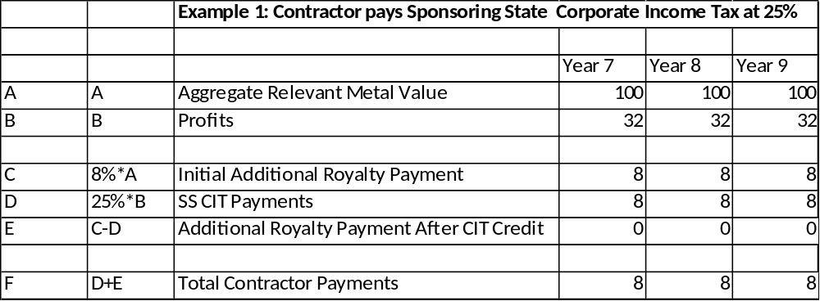
Simplified worked example of African Group proposal (for illustration only)

Slide 24
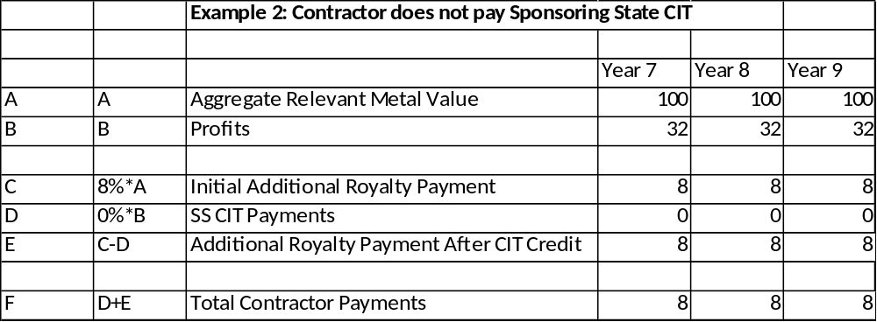
Simplified Worked Example of African Group Proposal (for illustration only)

