Slide 1



The economic value of ecosystem services and natural capital of the Area
Kingston, Jamaica, 20 March 2024 – 29th session of the ISA Council
Dr. Luke Brander
lukebrander@gmail.com

Slide 2
Outline
Environmental externalities
  Definition and examples
  Policy instruments for controlling externalities
  Dual purpose of environmental taxes
  Examples for extractive industries
Value of ecosystem services from the Area
  Ecosystem services
  Economic values
  Impacts of deep-sea mining on ecosystem services
Guidance on the economic valuation of ES from the Area
  Selection of valuation methods
  Assessing uncertainties
Conclusions and recommendations
  Primary valuation studies on key ES provided by the Area
  Transparency regarding the methods, data and analysis

Slide 3
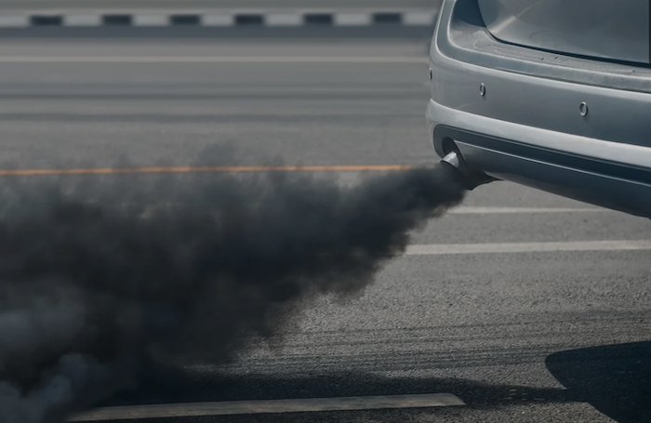
Introduction to environmental externalities
Definition: An external effect or externality occurs when the production or consumption decision of one economic agent has an impact on the utility or profit of another agent in an unintended way, and no compensation is made.
Externalities lead to sub-optimal use of resources from the perspective of society.
Production and consumption activities that generate external costs will tend to exceed socially optimal levels.
Example: Petrol cars and air pollution
  Car drivers pay the (private) costs of running cars
  Air pollutants from cars cause respiratory illness and pedestrians bear the (external) costs
  Society would be better off with lower use of old cars
  But car drivers have no incentive to drive less or switch to cleaner cars

Slide 4


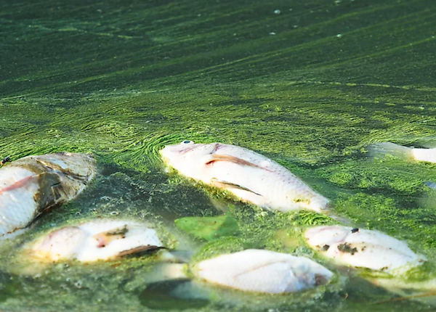
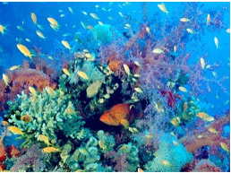
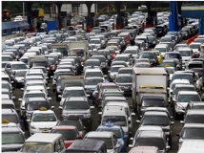
Examples of common environmental externalities
 | Externality | Sources | Recipients of the external cost
 | Climate change | Fossil fuel use; Deforestation | Present and future generations impacted by climate change
 | Air pollution | Factory emissions; Transportation | Exposed populations
 | Eutrophication | Agricultural use of fertilisers | Downstream water users; Fisheries
 | Biodiversity loss | Activities causing habitat loss | Present and future generations that hold values for biodiversity
 | Traffic congestion | Road users | Other road users

Slide 5
Policy instruments to control externalities
Direct regulation | Tradeable permits | Environmental taxes
Production restrictions Input restrictions Technology requirements Emission limits | Carbon credits (e.g. EU emission trading scheme) Fisheries individual transferable quotas (ITQs) | Carbon pricing Petrol tax Congestion charge
Environmental taxes have dual purpose or “double dividend”:
  Revenue raising (to fund mitigation, compensation or reduction of other taxes)
  Incentives to abate negative impacts by internalising the external cost
Examples for extractive industries:
  US fossil fuel royalty rates (Hein and Cecot, 2017)
  European taxes on aggregate mining (Söderholm, 2011)
  Key challenge to set taxes equal to external costs, which are inherently variable
Information requirements: quantification of marginal external cost
  Biophysical quantification of impact pathway +
  Economic quantification of welfare impacts

Slide 6
Value of ecosystem services from the Area
Questions on the impact pathway from mining activities to value of external costs:
  What are the key ecosystem services provided by ecosystems in the Area?
  What is the economic value of deep-sea ecosystem services and biotic natural capital?
  What are the likely impacts of mining operations in the Area on ecosystems and their services?
Methods:
Literature Review | Expert Consultation
Multiple sources and existing reviews (Armstrong et al. 2012; Folkersen et al., 2018) Journal articles, working papers, grey literature Criteria for valuation studies: Monetary units Primary valuations (not value transfers) 17 studies on deep-sea ecosystem services 7 studies on value of ecosystem services 82 studies on impacts of deep-sea mining | 25 experts identified from the literature and recommendations 10 experts agreed to participate Semi-structured interviews (0.5-1.5 hours) on the questions above

Slide 7
Value of ecosystem services from the Area
Key ecosystem services from the Area
Ecosystem Service | Abyssal plains (nodules) | Seamounts (crusts) | Hydrothermal vents (sulphides)
Food (fisheries) | 7 | 7 | 7
Genetic resources (pharmaceutical) | 2 | 2 | 7
Bio-mimicry | 1 | 1 | 5
Carbon sequestration and storage | 5 | 2 | 5
Biogeochemical cycling | 1 | 1 | 4
Existence and bequest value for biodiversity | 4 | 6 | 4
Aesthetic | 1 | 1 | 1
Tourism and recreation | 1 | 1 | 1
Historical archive | 1 | 1 | 3
N = number of studies
Expert judgement:
= high importance
= low importance
= no consensus

Slide 8
Value of ecosystem services from the Area
Economic values of Ecosystem Services from the Area
Ecosystem Service | Ecosystem | Number of value estimates
Food (fisheries) | Deep-sea | 1
Genetic resources (pharmaceutical) | Deep-sea | 2
Bio-mimicry | - | -
Carbon sequestration and storage | Deep-sea | 1
Biogeochemical cycling | - | -
Existence and bequest value for biodiversity | Deep-sea; Sea Canyon; Sea Mounts | 6
Aesthetic | - | -
Tourism and recreation | - | -
Historical archive | - | -

Slide 9
Value of ecosystem services from the Area
Existence and bequest values for conservation of deep-sea biodiversity
Ecosystem | ES description | Valued change | USD/household/year | % of respondents that are willing to pay | Reference
Sea canyon in Bay of Naples, Italy | Willingness to pay for the restoration of the Dohrn deep-sea canyon in the Bay of Naples | Restoration of deep-sea canyon to "high" biodiversity | 29 | 58% | O'Connor et al (2020)
Sea floor, seamounts and canyons off New England, US | Willingness to pay for expansion of MPAs to conserve seamounts and canyons | 2.27% increase in MPA coverage | 26 | 76% | Wallmo and Edwards (2008)
Deep-sea in Scottish EEZ | Increase from 1000 to 1300 species protected | 30% increase in species numbers | 26 |  | Jobstvogt et al (2014)
Deep-sea in Mediterranean | WTP for protection of a percentage of deep-sea species in Mediterranean | 5% increase deep-sea species protected (from 5% to 10%) | 8 | 55% | Carlesi et al (2023)
Open ocean and coastal waters of the Azores, Portugal | WTP for protection of a percentage of marine species of the Azores | 10% of invertebrates protected | 13 | 77% | Ressurreicao et al (2011)
Deep-sea coral in Irish EEZ | WTP for protection of deep-sea corals | Increase MPA to cover all deep-sea coral | 1 |  | Wattage (2011)

Slide 10
Value of ecosystem services from the Area
Impacts of deep-sea mining on ecosystem services
Impact category | Abyssal plains | Seamounts | Hydrothermal vents | Water column
Habitat Destruction and Biodiversity Loss | 24 | 10 | 19 | 8
Sediment disturbance | 15 | 3 | 12 | 6
Carbon disturbance | 2 | - | 1 | -
Noise pollution | 14 | 12 | 13 | 17
Chemical pollution | 3 | 2 | 1 | 6
N = number of studies

Slide 11
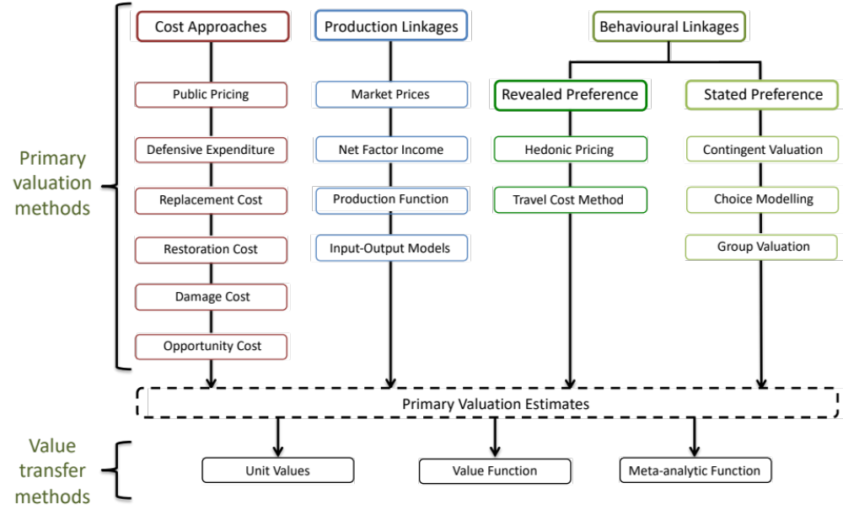
Guidance on economic valuation
“Tool box” of methods for valuing ecosystem services

Slide 12
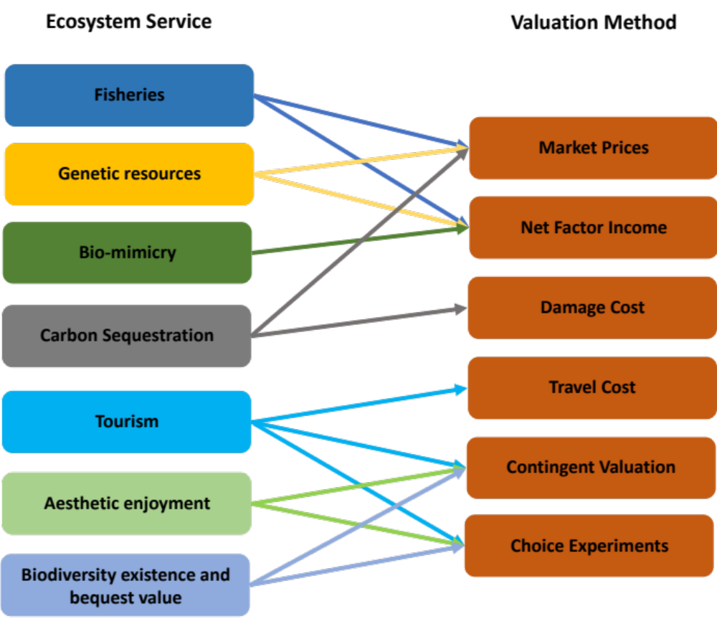
Guidance on economic valuation
Selecting valuation methods for specific ecosystem services
For each method:
  Indication of study times and costs
  Applicability
  Limitations
Step-by-step in the valuation process
Reference to detailed guidance material

Slide 13
Guidance on economic valuation
Assess and communicate uncertainties
The uncertainty of economic values is “stacked” on the uncertainty of biophysical impacts
Different decision-making contexts require different levels of certainty
Low certainty requirement
High certainty requirement
Awareness raising
Natural capital accounting
Policy Appraisal
Policy design
Compensation and litigation
e.g. public information campaign
e.g. green GDP
e.g. evaluation of investments
e.g. environmental taxes
e.g. legal claims

Slide 14
Conclusions and recommendations
Conclusions
  Very limited available information on the value of ES from the Area
  No existing information on how many people attach value to the conservation of biodiversity in the Area
  Insufficient basis for value transfers to estimate external costs of mining activities
Recommendations
  Primary valuation studies for key ES provided by ecosystems in the Area
    Genetic resources (expected future value of pharmaceutical and industrial applications)
    Existence and bequest values for conservation of biodiversity
  High transparency regarding the methods, data and analysis
    Sharing of results and common reporting standard
    Synthesis to enable transferability of valuation results

Slide 15
Thank You!

