Slide 1
An equalization measure for deep-seabed mining in the Area
1
Presented by: Daniel Wilde (d.wilde@commonwealth.int) June 2024

Slide 2
Summary of the thematic discussion (March 2024)
The 1994 Implementing Agreement Section 8.1.b provides that ‘The rates of payments under the system shall be within the range of those prevailing in respect of land-based mining […]’.
The effective tax rate for a mine is a good measure of ‘rates of payment’.
The effective tax rate = payments to government/profits (over the life of the mine).
The average effective tax rate for land-based mining is 43%, and this is a good effective tax rate to target for deep-seabed mining (DSM).

Slide 3
Summary of the thematic discussion (March 2024)
$2.6 billion
$3.7 billion

Slide 4
Summary of the thematic discussion (March 2024)
5. There is a need for an equalization measure to ensure a 43% effective tax rate regardless of sponsoring state tax exemptions.
Under all equalizations measures
a.) a contractor that pays little or nothing to its sponsoring state pays more to the ISA; and
b.) a contractor that makes significant payments to its sponsoring state pays little or nothing under the equalisation measure
the equalization measure is in addition to the ISA base royalty. Thus, it cannot reduce ISA revenue from a mine.

Slide 5
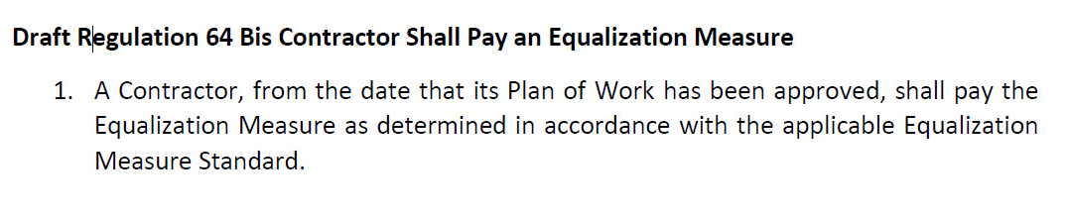
Summary of the thematic discussion (March 2024)
6. The Exploitation Regulations need to include text requiring contractors to pay the equalization measure. However, the details of the measure can be included in a standard.
[The below text is from the draft submission already circulated to the working group]

Slide 6
Summary of the thematic discussion (March 2024)
Two possible equalization measures
Option 1: Hybrid
if a contractor receives tax exemptions or subsidies then it pays an additional royalty of 8% against which payments to the sponsoring state are creditable;
in the alternate, the contractor pays a 25% profit share (on profits from all related entities from mining activities) to the ISA from which royalty payments to the sponsoring state and all mining payments by related entities are creditable.

Slide 7
Summary of thematic discussion (6)
Option 2: Profit Share
the contractor pays a 25% profit share to the ISA against which its payments to the sponsoring state are creditable.

Slide 8
Summary of thematic discussion (7)
Key benefits of both equalization measures:
disincentivise sponsoring state tax avoidance.
help ensure a level playing field with land-based mining.
can increase but not decrease ISA revenues from a mine.
create a level playing field between contractors regardless of tax exemptions and subsidies.

Slide 9
What definition of profits is the profit share component of the hybrid applied to?
Profits from mining activities (to be defined by the ISA) by related entities (as defined by GloBE). With royalty payments to the sponsoring state and all tax payments by related entities to all states from mining activities creditable.
Related Entity (Parent Company)
Related Entity not undertaking mining activities
Related Entity undertaking mining activities
Contractor

Slide 10
What profits is the option 2 profit share applied to?
Related Entity (Parent Company)
Related Entity undertaking mining activities
Related Entity undertaking mining activities
Contractor

Slide 11
The hybrid equalization measure
Hybrid
Advantages
builds on earlier work by the Africa Group on the additional royalty and by contractors on the GloBE profit share
uses definitions of covered taxes, income and related entities from GloBE
protects against profit shifting between related entities and jurisdictions
Disadvantages
potentially vulnerable to profit shifting from inside to outside the mining perimeter/definition of mining activities
it is unusual in extractive industry taxation to have a hybrid
mining activities must be defined
quite complicated

Slide 12
The profit share equalization measure
Advantages
Cash flow profit shares are a well-established fiscal instrument in extractive industry taxation.
The text is complete, except for some administrative provisions.
Immediate expensing and the ineligibility of interest expense constraint transfer mispricing of costs to some extent.
Disadvantages
Potentially vulnerable to profit shifting from the contractor to related entities

Slide 13
Conclusion
Way forward:
a.) agree on the preferred equalization measure, and
b.) finalise the text for that measure.

Slide 14
Disclaimer
The views and opinions expressed in this Presentation are those of the presenter and do not necessarily represent the views of the Commonwealth Secretariat or any Commonwealth member country.

